Slide 1
FLOW CONTROL
And general understanding about pumps
P4 Student Presentation
Group ED4-1-F2018 AAU Esbjerg

Slide 2
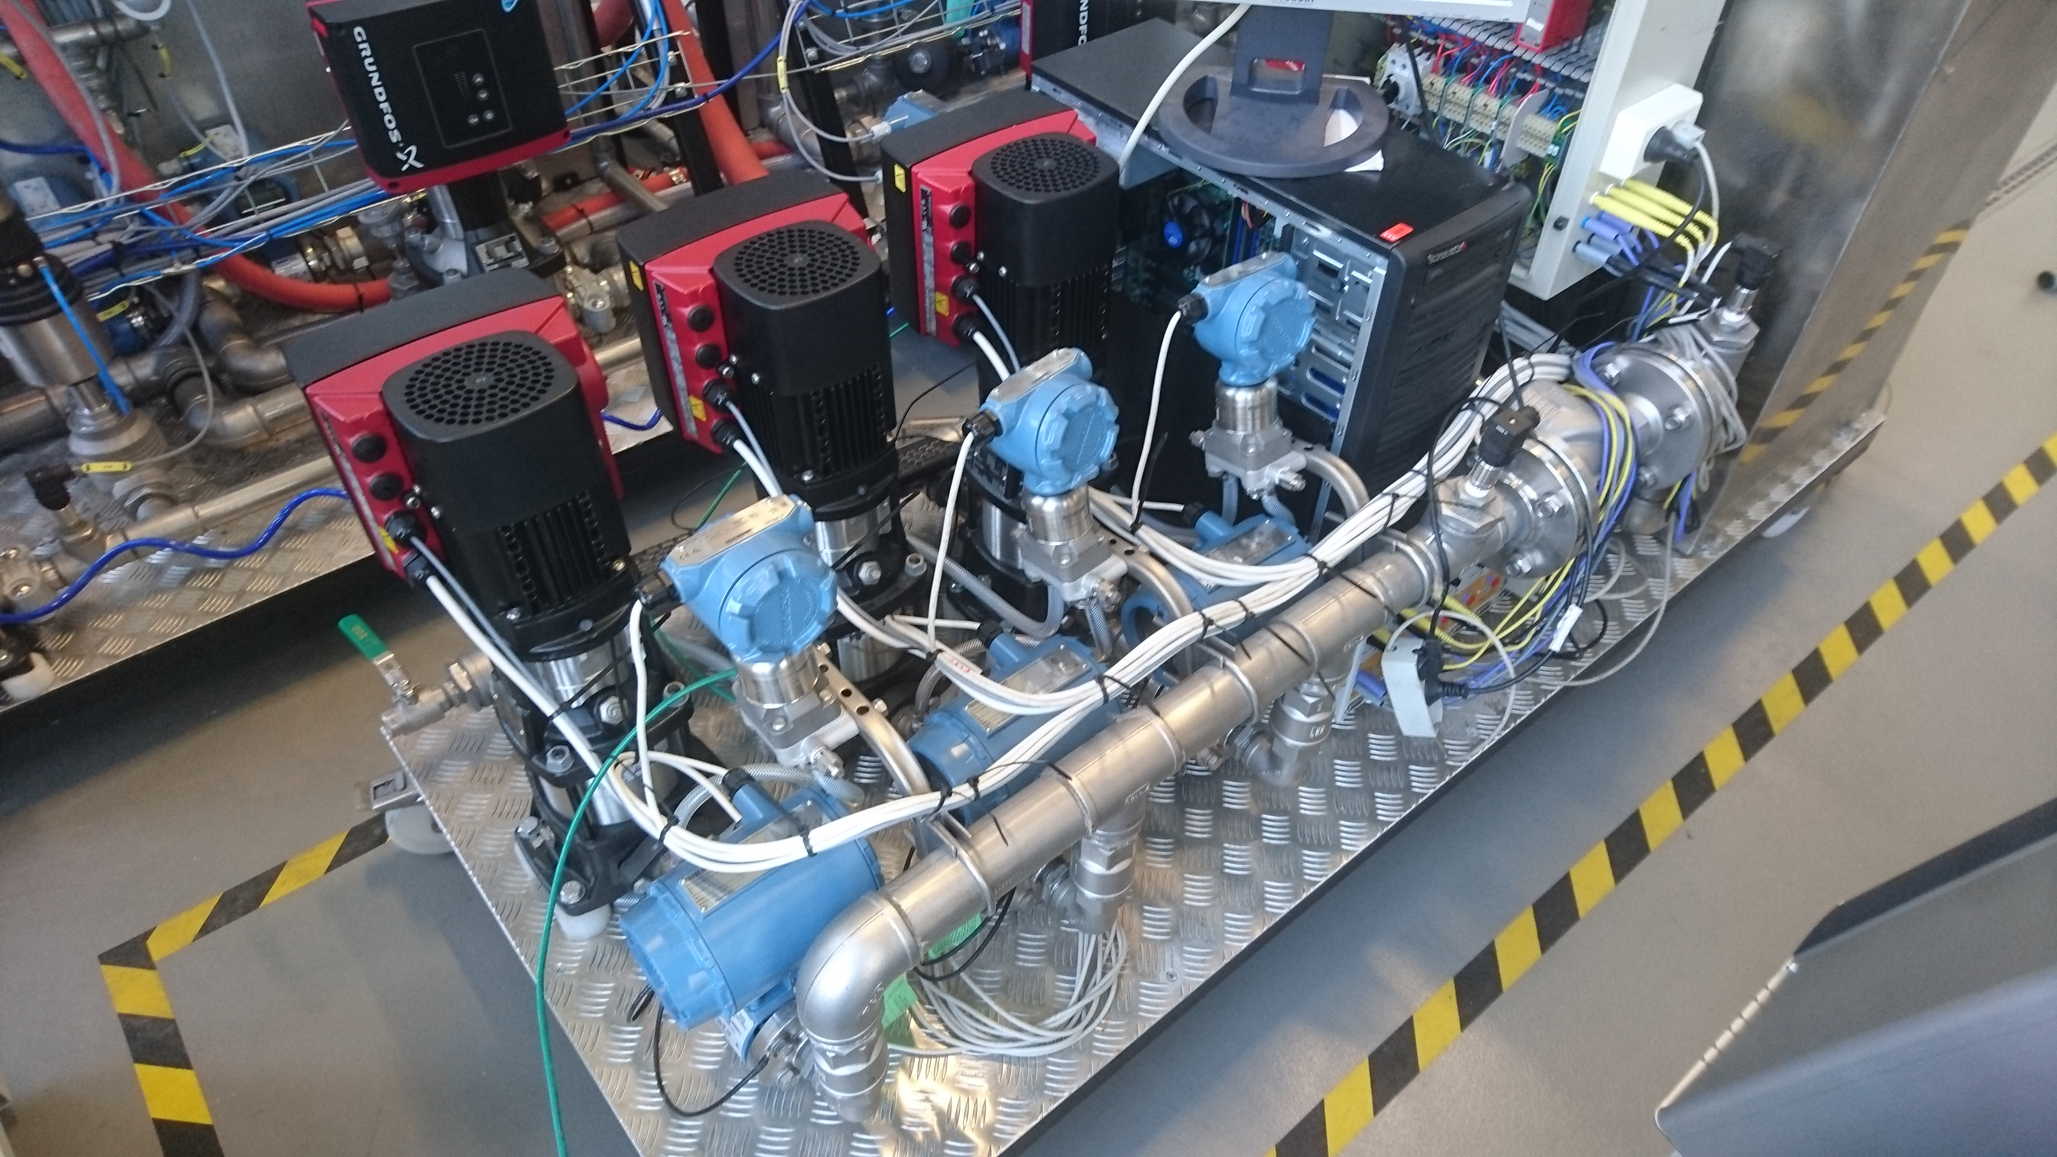
AGENDA
Troels – Introduction and data gathering
Razvan – Controller design
Daniel – Future work

Slide 3
INTRODUCTION
Why we chose to work with the pump system?
Working with an already existing system compared to building a system from the ground up.
At first we wanted to optimize the energy consumption by running 1, 2 or 3 pumps depending on what would be most efficient. (Daniel)
Changed direction - End goal was to analyse the pump-system and model it mathematically, in order to control a constant flow using a PID controller.
Notes:
We chose to work with the pump-system because we thought it would be interesting to work with something that was completely new and challenging.
The 3-pump system was already avaliable to work with, which also was a change from our previous projects were we build everything from scratch. That doesn’t mean it was any easier, because we didn’t know how anything about how it worked and it turned out there was quite a steep learning curve. (just to get to it do anything).
At first we wanted to optimize the energy consumption by selecting between running 1, 2 or 3 pumps depending on what would be most efficient.
(Daniel will present what we did in that area, after the report was handed in).
Mention we changed direction since it was a bit ambitous within the given timeframe.

Slide 4
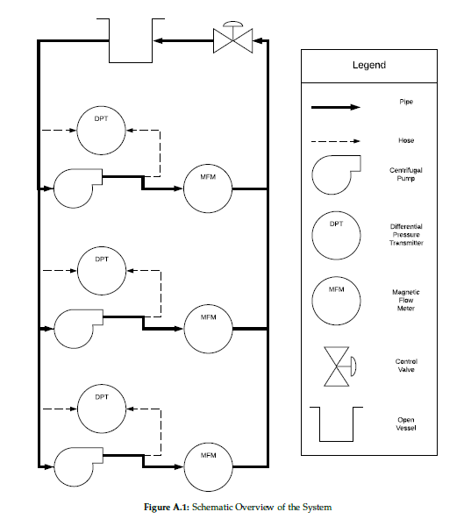
PHYSICAL SETUP SUMMARY
Schematic overview of pump system
The system’s individual parts
Controllable inputs - Individual pump speed - Control valve
Measurable outputs - Individual flow for each pump - Individual differential pressure for each pump - Individual power consumption for each pump
Notes:
The system consists an open water tank, and 3 identical centrifugal pumps in parallel, with individual sensors for measuring pressure and flow.
A control valve that can be operated to change the flow and pressure, or introduce disturbances to the system. Everything is connected together using pipes.
The controllable inputs + Measurable outputs

Slide 5
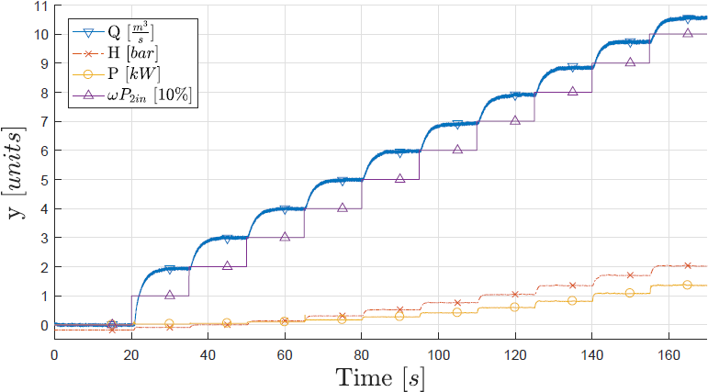
DATA GATHERING EXAMPLE
Correlation between Flow, Head, Power and Pump speed CV = 70% (Real-time view)
Analyzing how the system reacts in real-time
For gathering data we used a Simulink model and MATLAB Scripts
Example graph shows how a test was performed, with sensor data measured with control valve 70% open.
Several tests were conducted to identify the correlations between pump speed, backpressure, flow and power consumption.
Notes:
Learn how system reacts, relations between flow/pressure/pump speed etc.
To give some more insight in the testing, we wanted to show the data collected in
a single run.
While executing a run, the data for all used sensors was
shown on the target in real time.

Slide 6
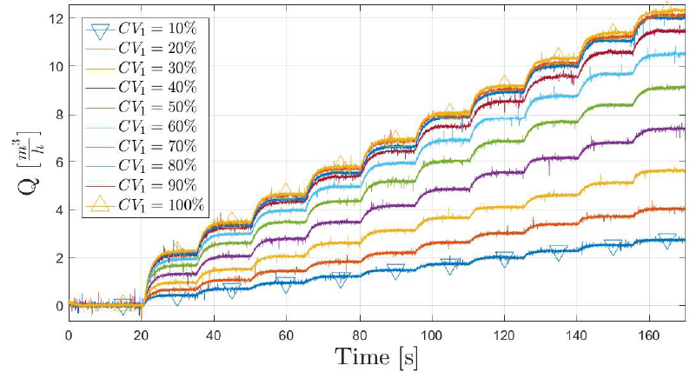
SYSTEM TEST (FLOW)
Raw flow data for control valve position 0-100% and pump speed 0-100%
Plotted toghether in one graph
To measure flow, pump speed was increased from 0-100% in 10% intervals every 15 seconds to let system stabilize.
This was done for all control valve positions in 10% intervals.
Steady-state can easily be seen.
Notes:
The following Figures shows the collected data through several
runs, each with a different CV and pump speed.
Starting from 0% pump speed (wP), we have increased wP
by 10% every 15 seconds. This was done in order to give the system some time to
stabilize. The process was repeated for a range of valve openings. Similar to wP,
the valve was in the beginning 10% open, gradually increasing by 10% and finally
reaching 100%.

Slide 7
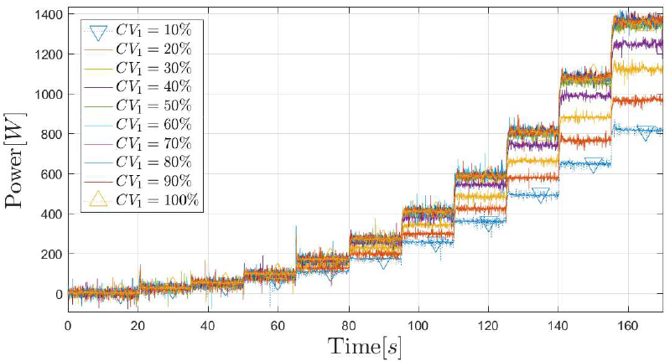
SYSTEM TEST (POWER)
Raw power data for control valve position 0-100% and pump speed 0-100% Plotted toghether in one graph
Same procedure as before, running at all different pump speeds with control valve position changed.
Steady-state can easily be seen, but more fluctuating.
Notes:
Same procedure as before, running at all different pump speeds with control valve position changed.

Slide 8
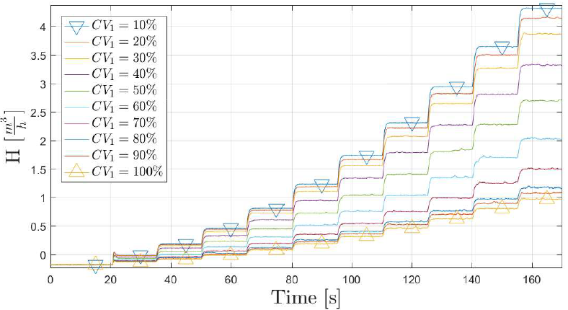
SYSTEM TEST (HEAD)
Raw head data for control valve position 0-100% and pump speed 0-100%
Same procedure as before, running at all different pump speeds with control valve position changed.
bar

Slide 9

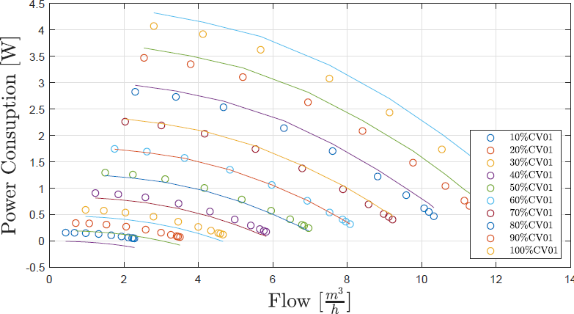
STATIC MODEL VALIDATION PUMP CURVES
Mathematical steady-state model (lines) compared to measured data (dots) for Pump curve
Pump curve validation: Comparison between our mathematical steady-state model (lines), and the actual data measured (dots).
The curve fitting is really accurate.
We are heavily filtering by taking the average over a lot of datapoints in the steadystate.
coefficients for the model were determined at 60% pump speed.
Error in report Should have been pump speed
Notes:
For the actual data we compared several runs, heavy filtering out noise by taking the average of the steady-state
Validation = Comparison between our mathematical model based on affinity laws, and the actual data measured.
The static model explains the behaviour of the system at steady-state, i.e. when
the output is settled after a step input.
Typical static models for pump systems are pump curves and system curves. (Daniel future work – 3D plots of comparing all 3 pumps and their efficency)

Slide 10
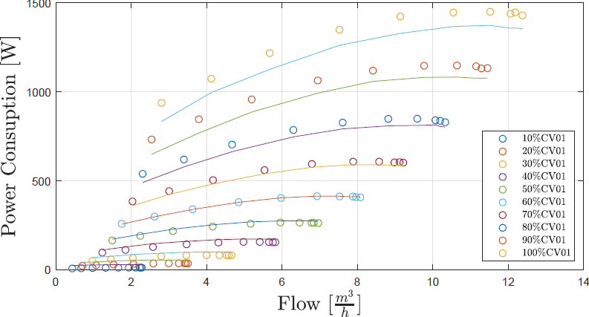
STATIC MODEL VALIDATION POWER
Mathematical steady-state model (lines) compared to measured data (dots) for Power and Flow
Again changes can be seen between the model and measured data, when moving away from the starting point (CV = 60%)
Some inaccuracy was expected, but we are not complete sure what causes this.
Error in report Should have been pump speed

Slide 11
Dynamic Modelling

Slide 12
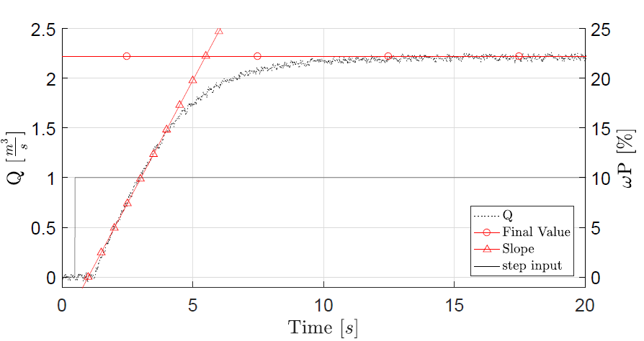
Unit Step Response
Process Reaction Curve
give a unit step input to the system
obtain process reaction curve
determine variables
model the system according to the transfer function
$$\frac{Y(s)}{U(s)} = \frac{Ae^{−st_{d}^{}}}{τs+1}$$
Step Response
Notes:
In order obtain a model for our system, and be able to develop a PID controller,
we have determined the process reaction curve of our system. This has allowed us to
develop a model and test different controllers on it.
The S – shape can be approximated using a first order transfer function, shown in the slides.
All the coefficients can be obtained from the figure.

Slide 13
Unit Step Response
Process Reaction Curve
give a unit step input to the system
obtain process reaction curve
determine variables
model the system according to the transfer function
R = 2.0236
L = $t_{d}$ = 0.75
A = 2.2
Step Response
Notes:
After obtaining the values we were able to model the reaction curve, and test different controllers on the models.

Slide 14
Ziegler-Nichols
Type of Controller | Optimum Gain
P | $$k_{P}=1/RL$$
PI | $$k_{P}=0.9/RL$$ $$T_{I}=L/0.3$$
PID | $$k_{P}=1.2/RL$$ $$T_{I}=2L$$ $$T_{D}=0.5L$$
Step Response
Notes:
We used Ziegler – Nichols tuning method. The coefficients are determined as shown in the table,
according to the type of controller that needs implementing. Results of the controllers on the models
can be seen in the following slides.

Slide 15
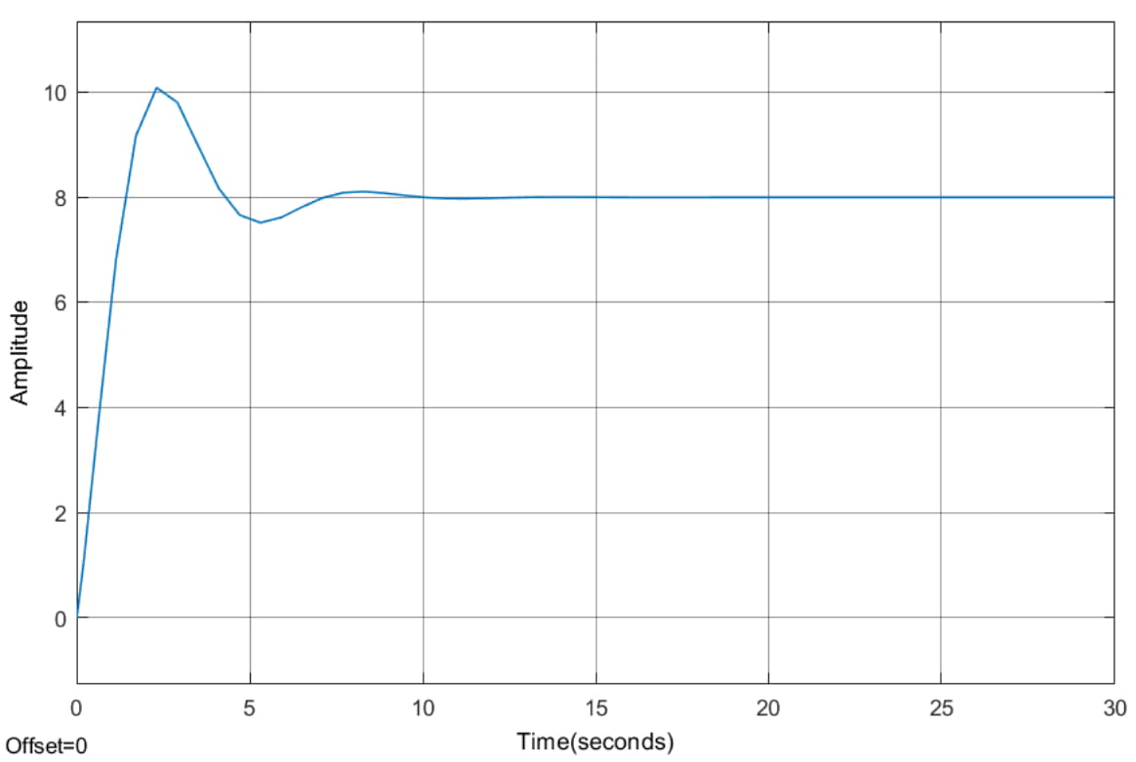
Model Testing – PI Controller
Notes:
The PI controller shows good behavior. With a slight overshoot but stabilizing relatively rapidly.
As noticed the quarter decay ratio seems to work, the second oscillation being approximately a quarter of the first,
With the third disappearing almost completely

Slide 16
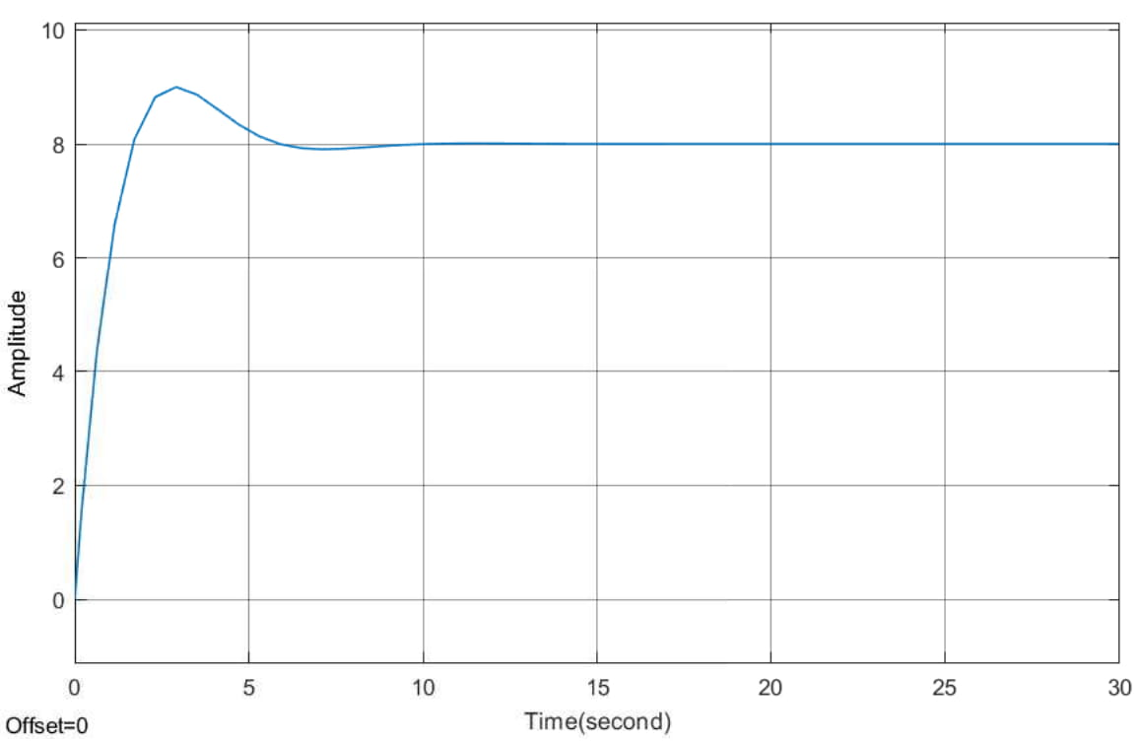
Model Testing – PID Controller
Notes:
The PID controller still presents some overshoot. We expected that to come from the aggressiveness of the controller.
The matter will be further discussed later on.

Slide 17
Controller Design

Slide 18
PID Controller
Continuously calculates an error as a difference between a setpoint and a measured variable, and applies a correction based on proportional, integral and derivative terms.
Proportional term produces an output proportional to the current error value
Integral term produces an output proportional to both the magnitude of the error and the duration of the error
Derivative term produces output determined by the slope of the error over time and multiplying this rate of change by the derivative gain
$$D_{cl}\left(s\right)= k_{P}+ \frac{k_{I}}{s}+k_{D}s$$
$$D_{cl}\left(s\right)= k_{P}(\frac{T_{I}}{s}+T_{D}s)$$
Notes:
A PID consists of a proportional, integral and derivative part.
The gains have to be tuned according to the dynamics of the plant, and the desired characteristics of the controller.
Manually or using certain tuning methods.
Used Ziegler – Nichols. Quarter Decay or Ultimate Sensitivity.
Standard and Ideal PID equations. Ideal PID more used in the industry.

Slide 19
Ziegler-Nichols
Quarter Decay Ratio
Requires Stable System
Unit Step Response
Open Loop Tuning Method
Step Response
Notes:
As stated we implemented the tuning method in practice and we got the following results.

Slide 20
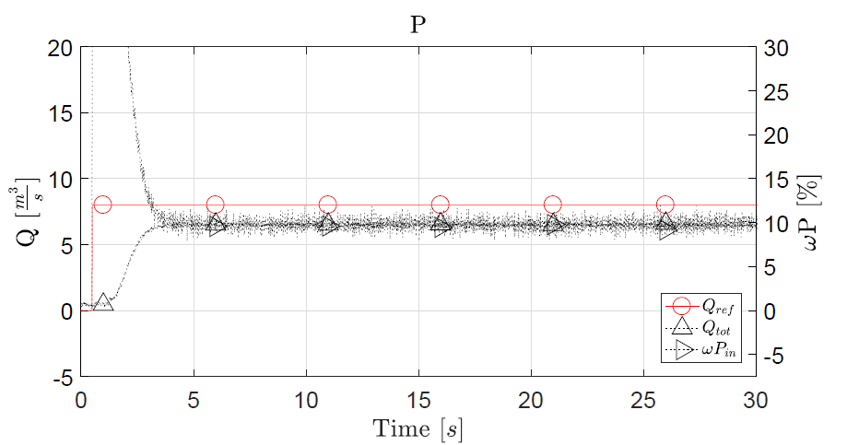
Results-P Controller
Notes:
The P-controller with the calculated value did not achieve any results,
as the error was too small to start the pump. To overcome this issue,
we multiplied kP with 10. This was solely done for the P-controller,
because the PI- and PID-controller gave proper results without this correction.
We expect this to be caused by the scaling factor before the input to the pumps.
However, it presents a high steady-state error. This being merely a P-controller,
further improvement is possible.

Slide 21
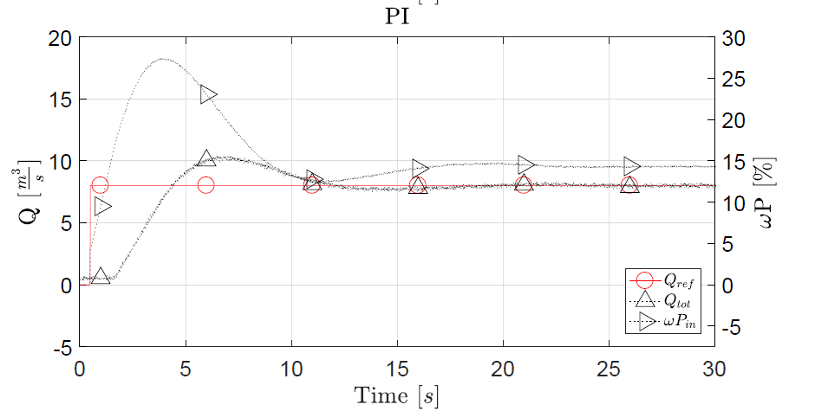
Results-PI Controller
Notes:
The PI-controller does not have a steady-state error, but the overshoot of approximately 25% doesn’t
fulfil our requirements either. The quarter decay ratio tuning method holds in practice as well as it does in theory.

Slide 22
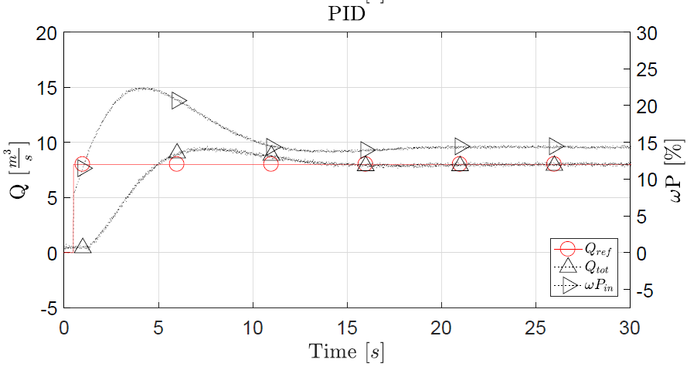
Results-PID Controller
Notes:
Interestingly, the PID-controller also has an overshoot above our limits,
which we expect to be caused by the ZN tuning. In the next step we tried
manually tuning the kD coefficient, to get an overshoot inside
our requirements.

Slide 23
Observations
P-controller settles fastest, however with very big steady-state error
PI-controller does not present a steady state error, however, the overshoot is rather big
PID-controller also has an unacceptable overshoot
Decided to manually tune $k_{D}$ term to achieve better results

Slide 24
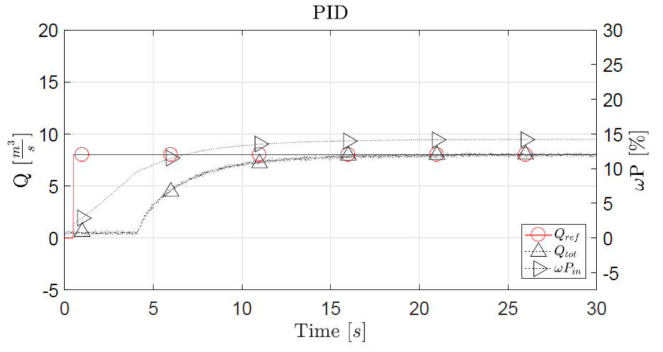
Results-Manually Tuned PID Controller
Notes:
It reacts almost 4 seconds later, than the reference point is given

Slide 25
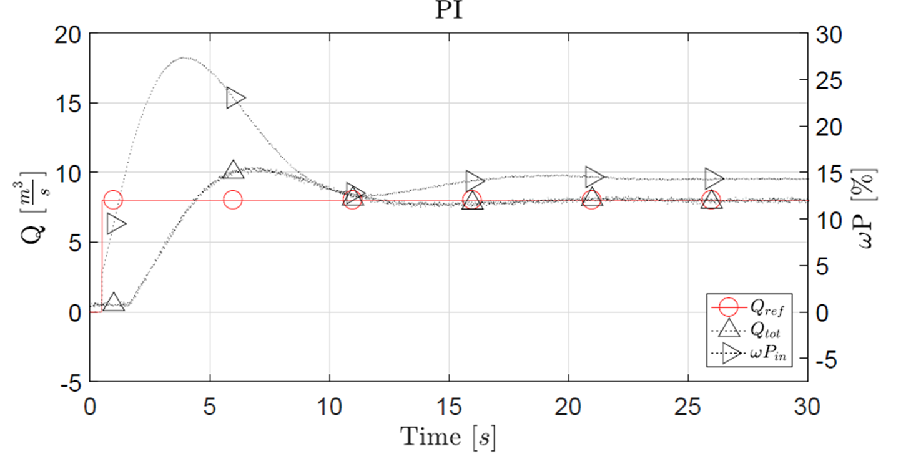

Comparison – PI Controller

Slide 26
Comparison – PID Controller

Slide 27
FUTURE WORK
Modelling of Power Consumption
Model Validation
Model Combination

Slide 28
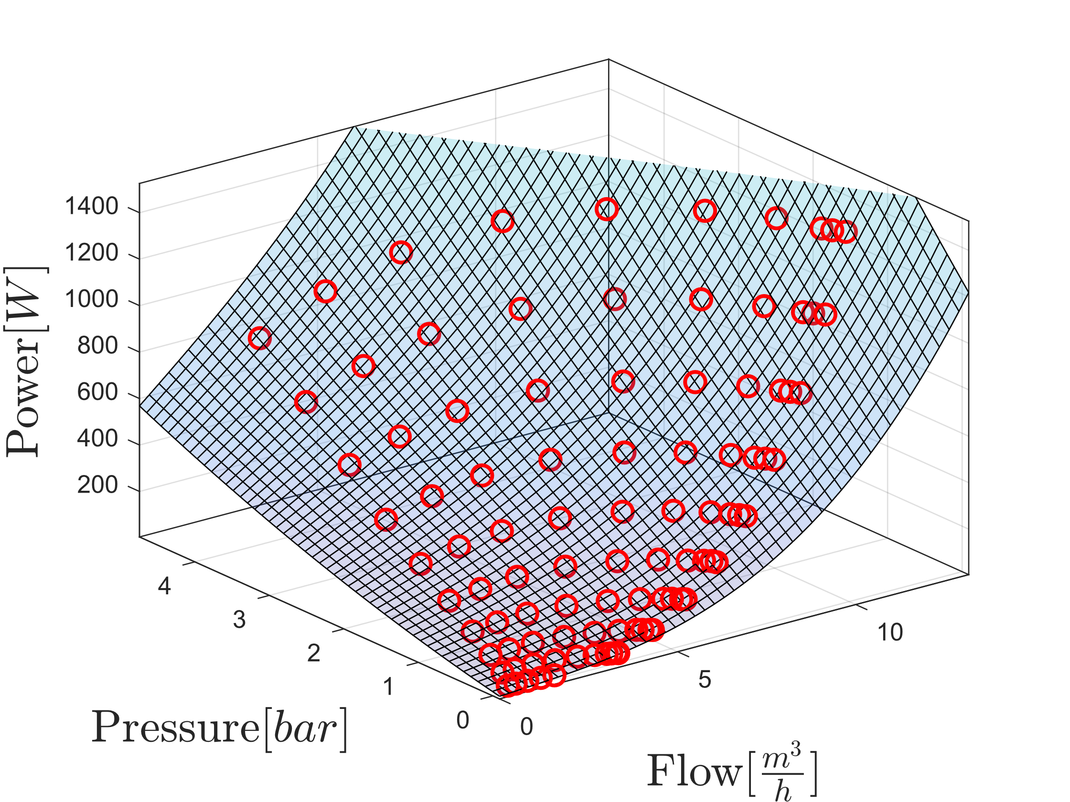
Power consumption
Model for single pump with collected data points in red

Slide 29
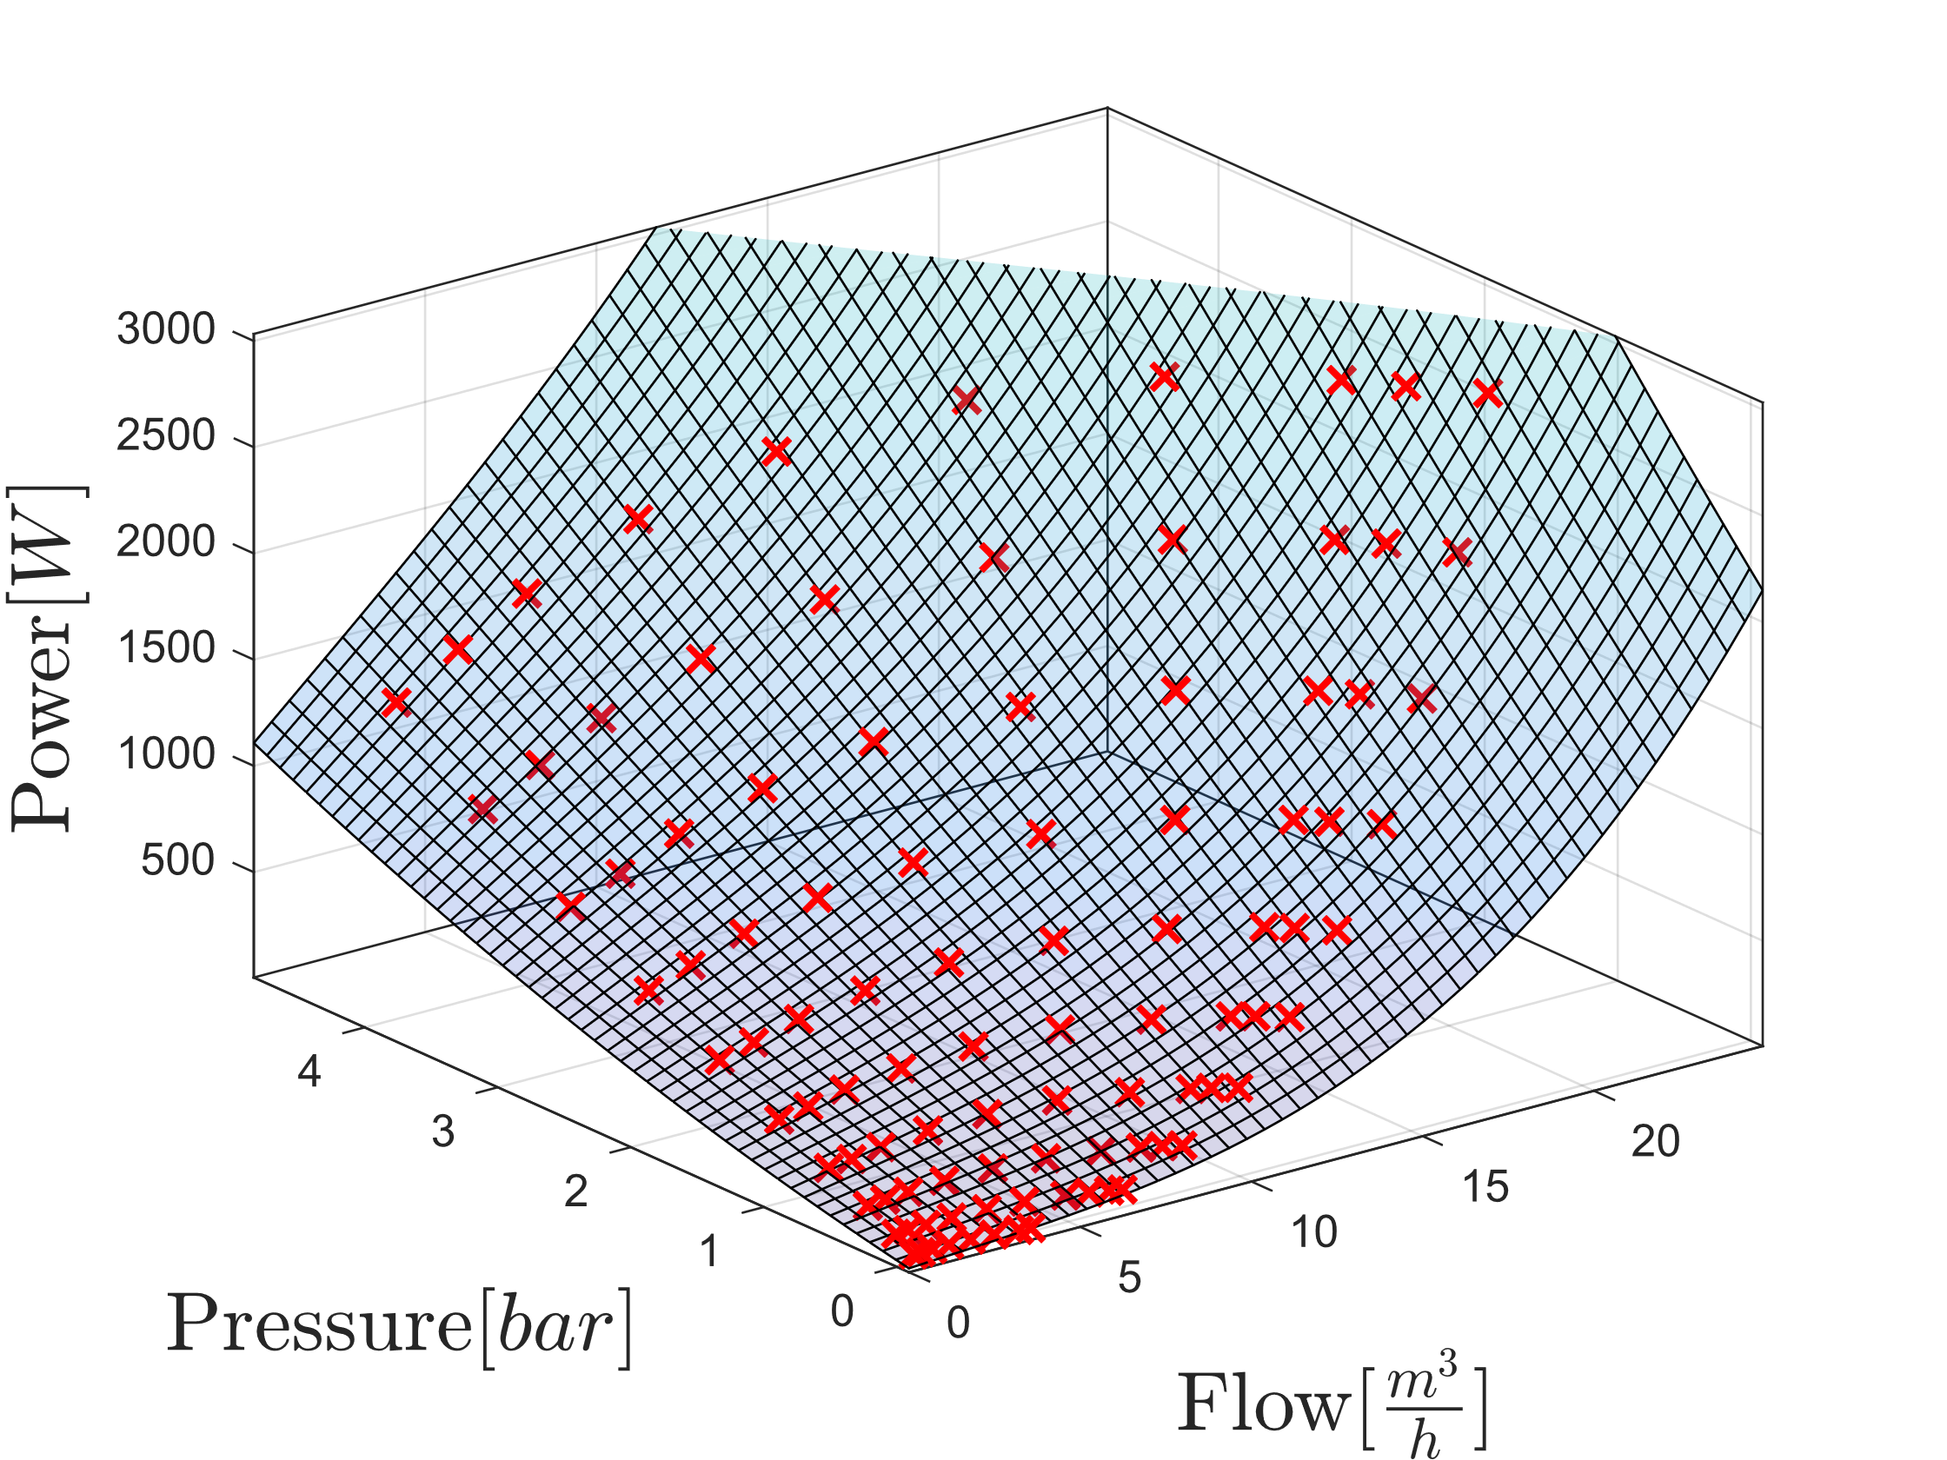
Power consumption
Model for two pumps with collected data points in red

Slide 30
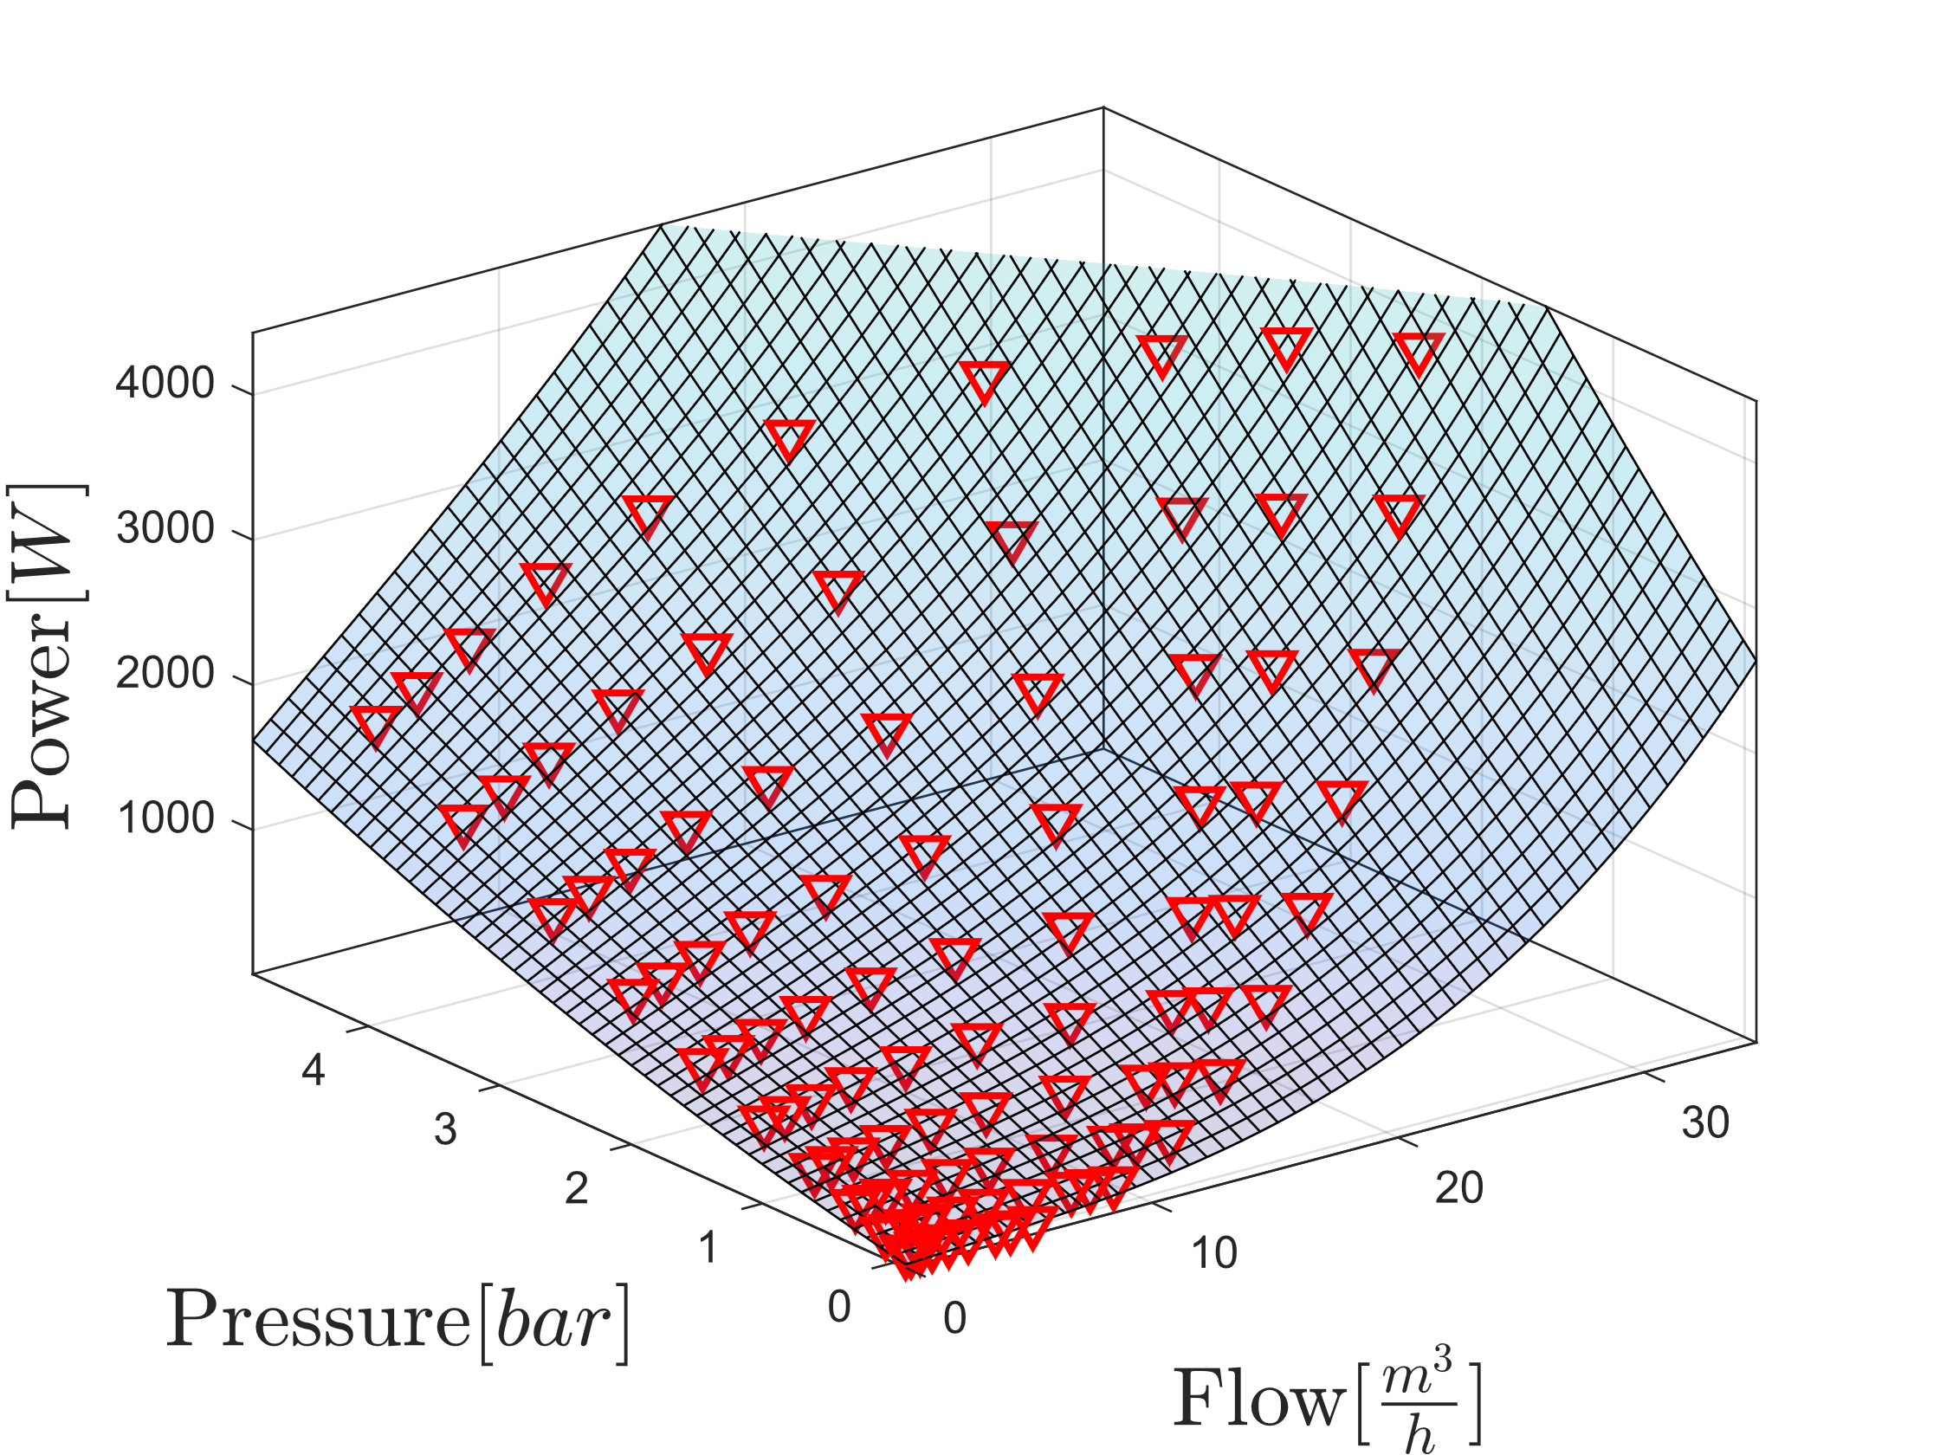
Power consumption
Model for three pumps with collected data points in red

Slide 31
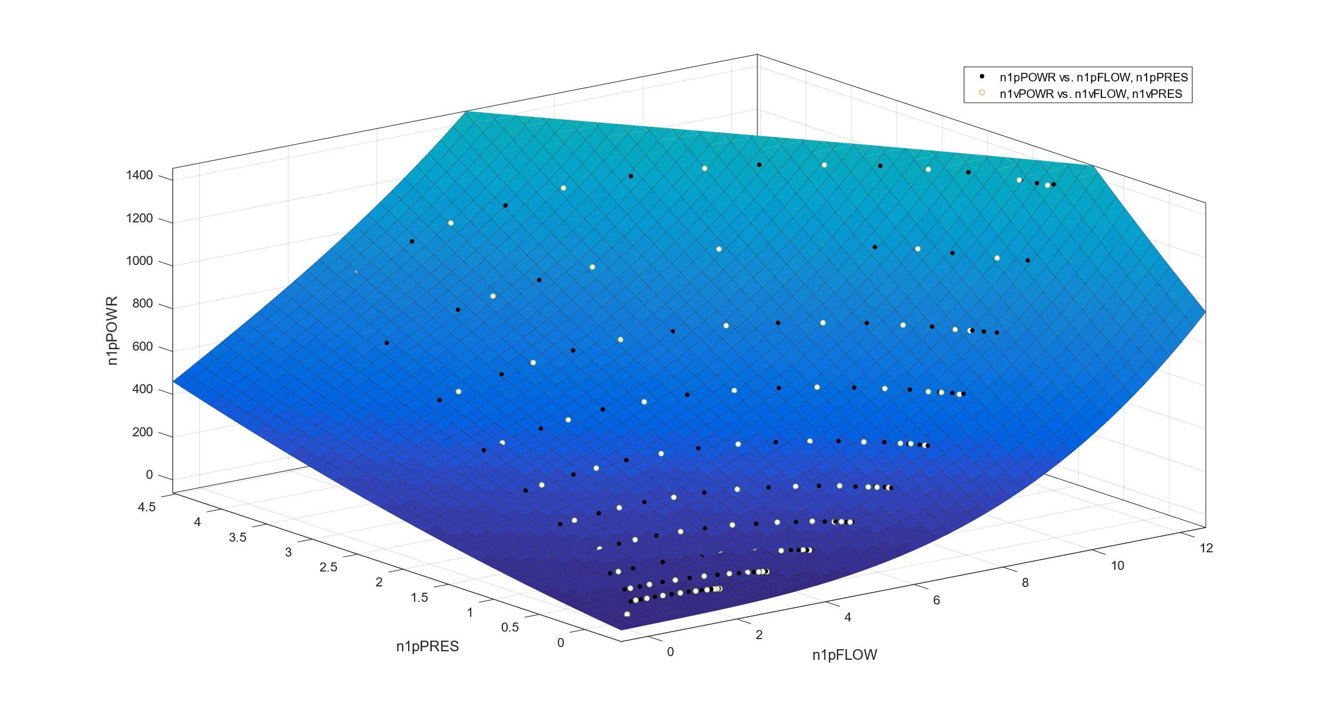
Model Validation
Validation for single-pump-model with validation data in white

Slide 32
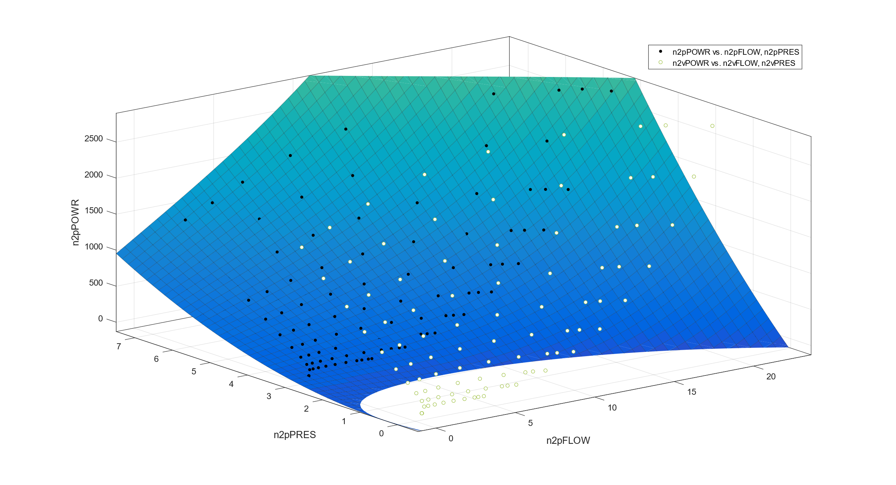
Model Validation
Validation for two-pump-model with validation data in white and pressure offset

Slide 33
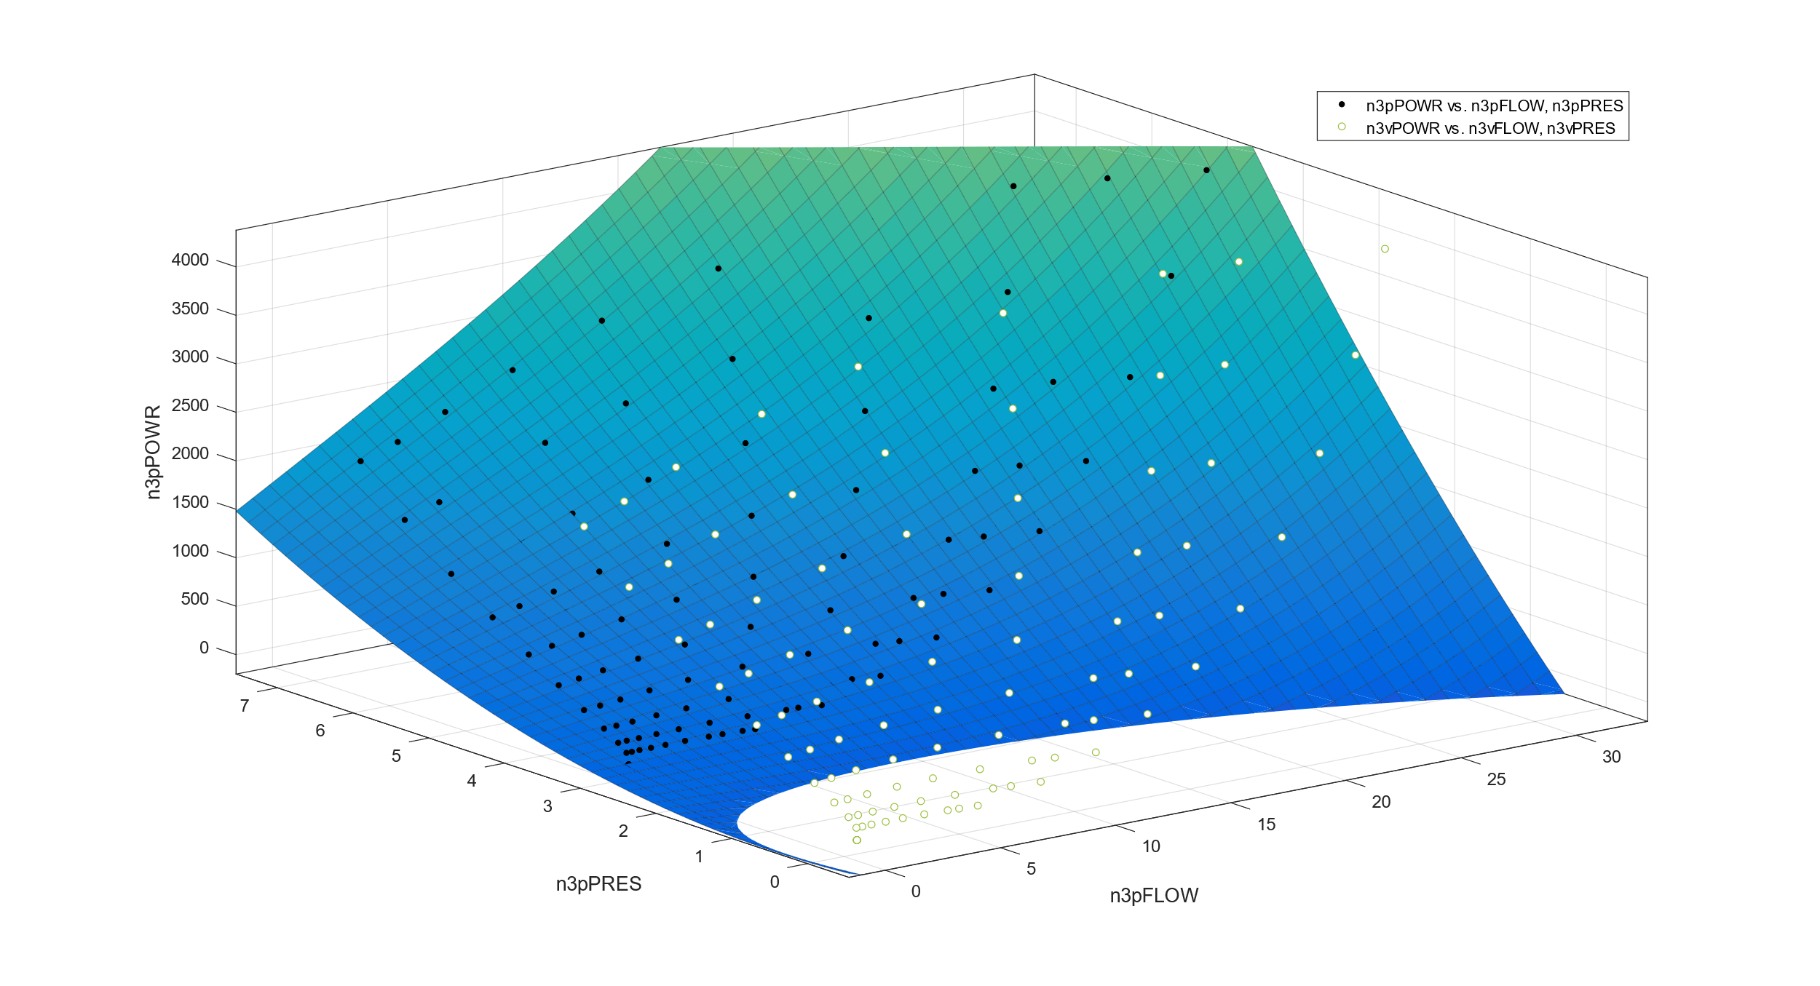
Model Validation
Validation for three-pump-model with validation data in white and pressure offset

Slide 34
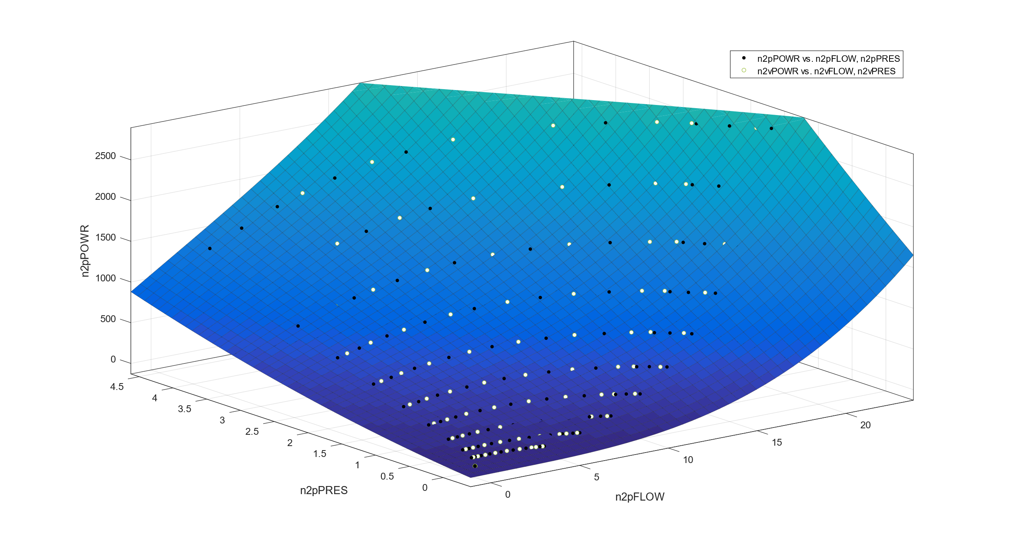
Model Validation
Validation for two-pump-model with validation data in white

Slide 35
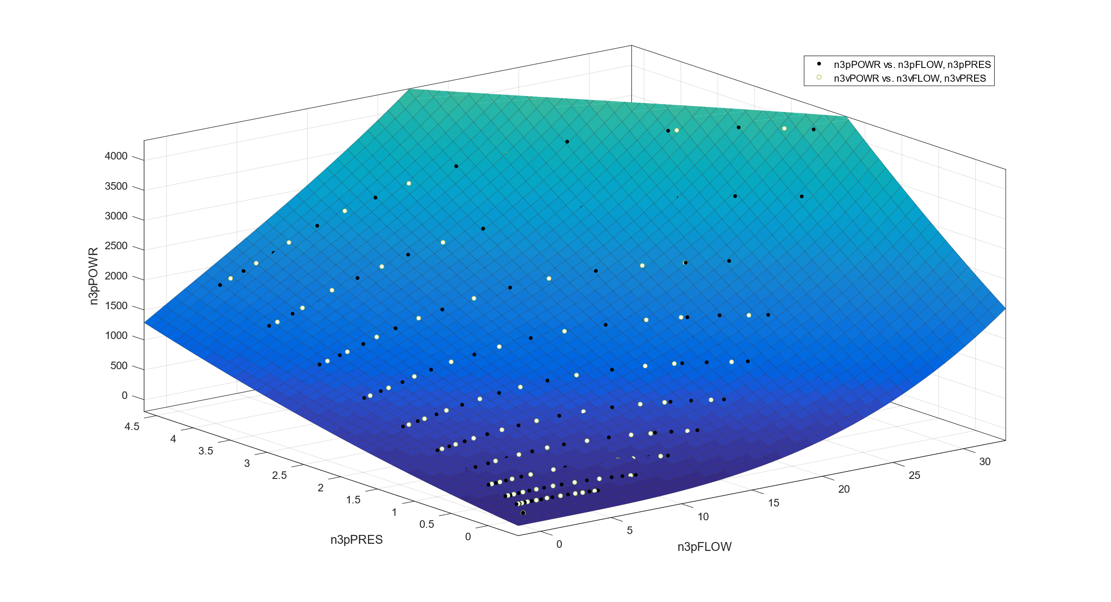
Model Validation
Validation for three-pump-model with validation data in white

Slide 36
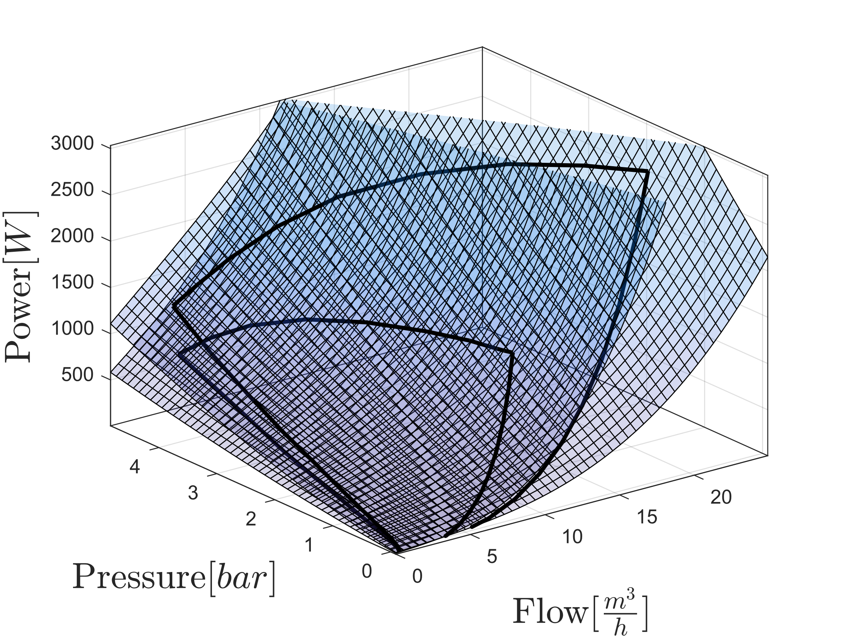
Model Combination
Combined Models for one and two pumps

Slide 37
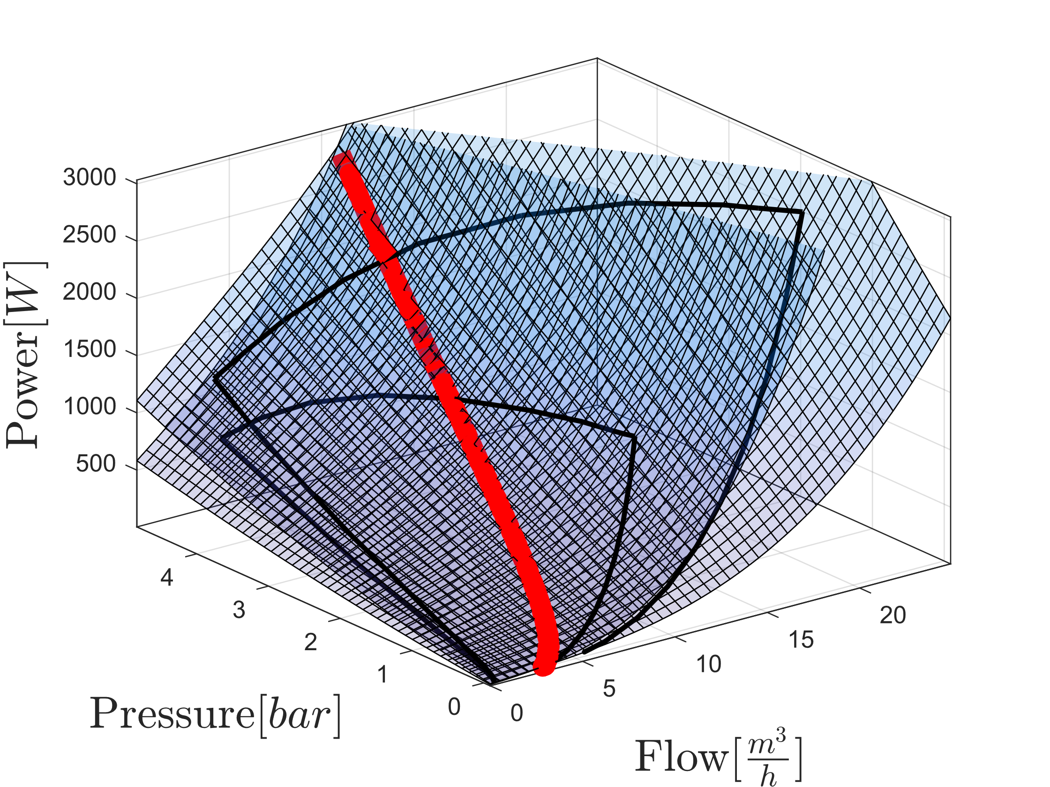
Model Combination
Combined Models for one and two pumps with intersection highlighted

Slide 38
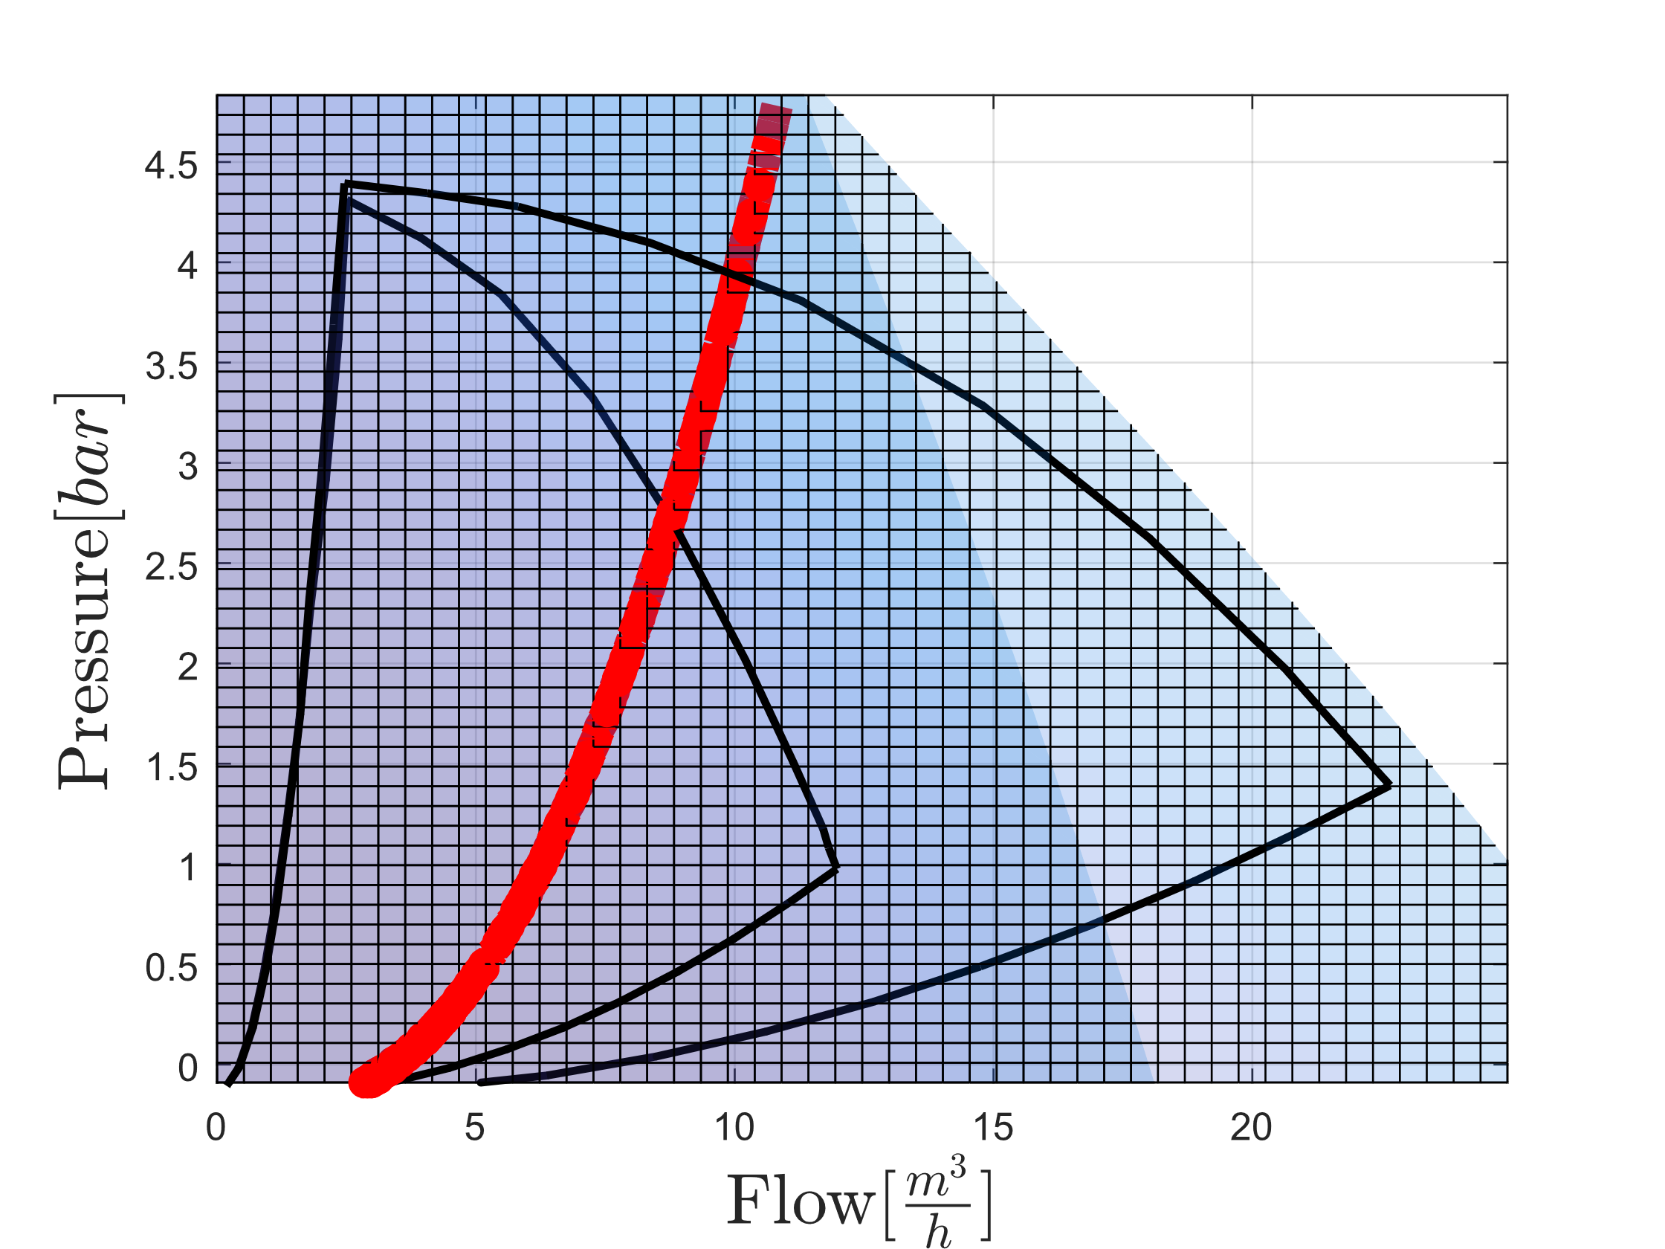
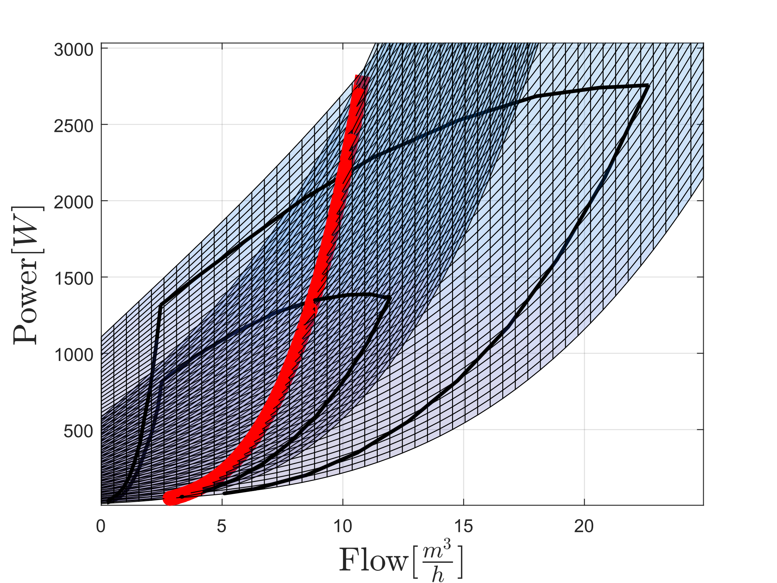
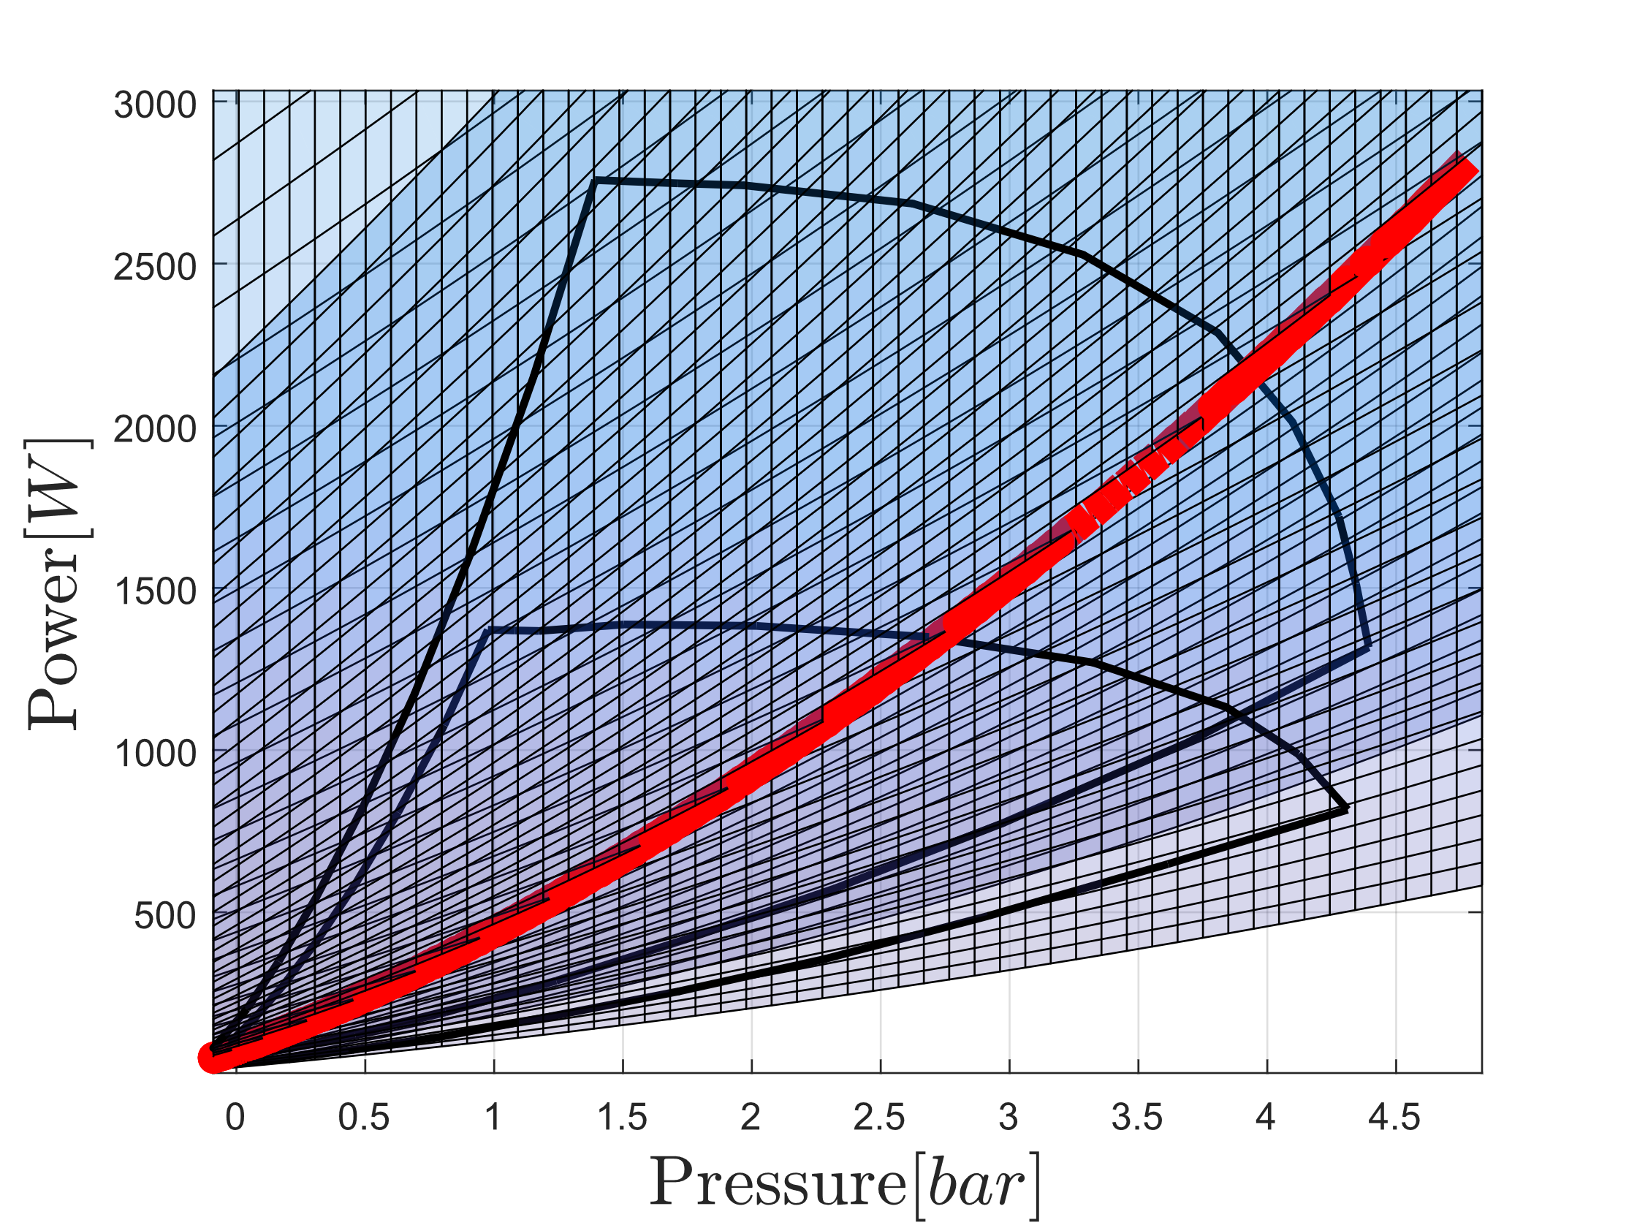

Slide 39
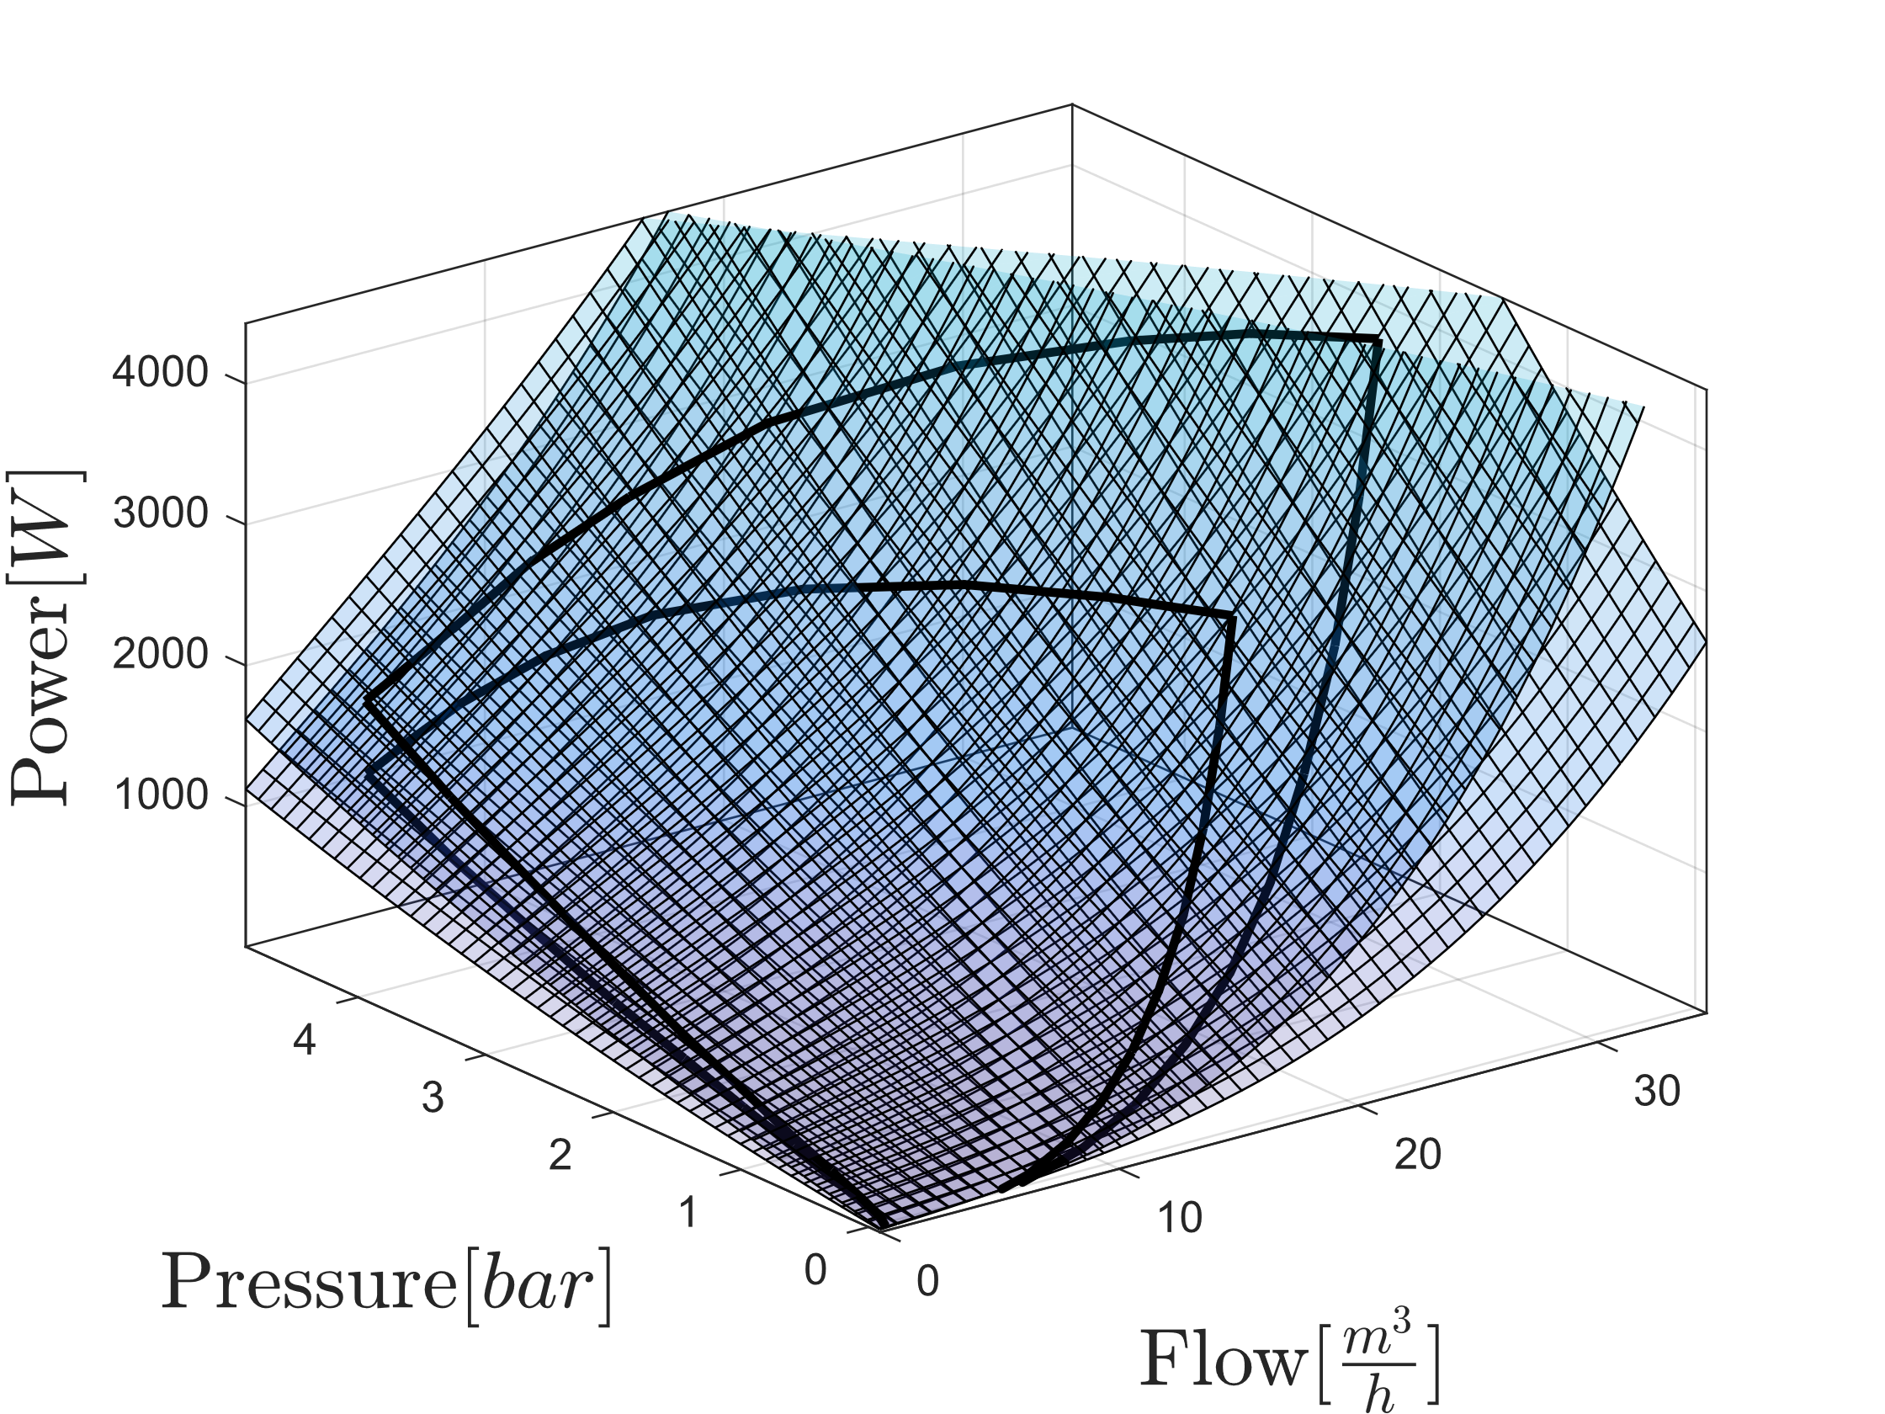
Model Combination
Combined Models for two and three pumps

Slide 40
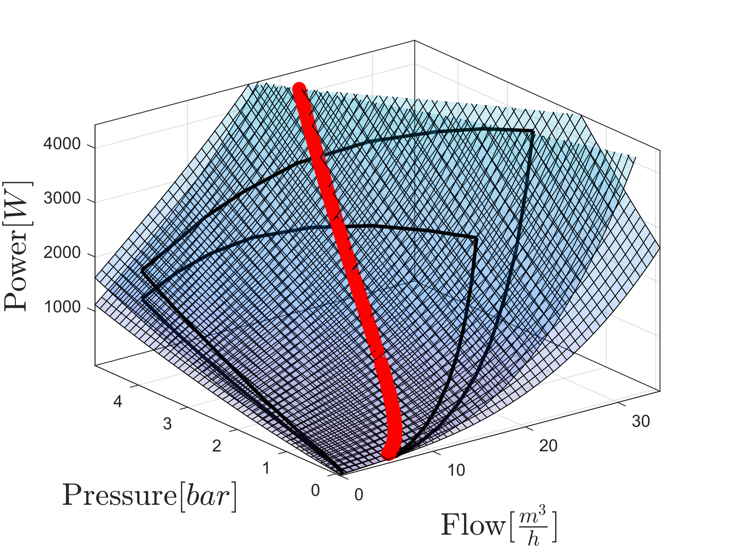
Model Combination
Combined Models for two and three pumps with intersection highlighted

Slide 41
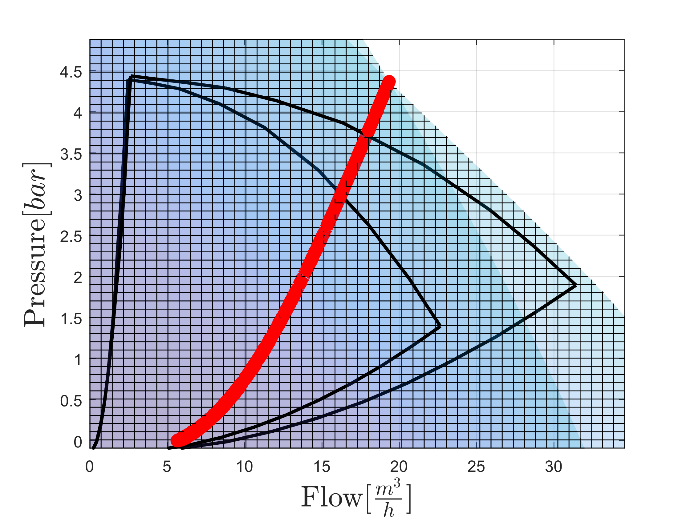
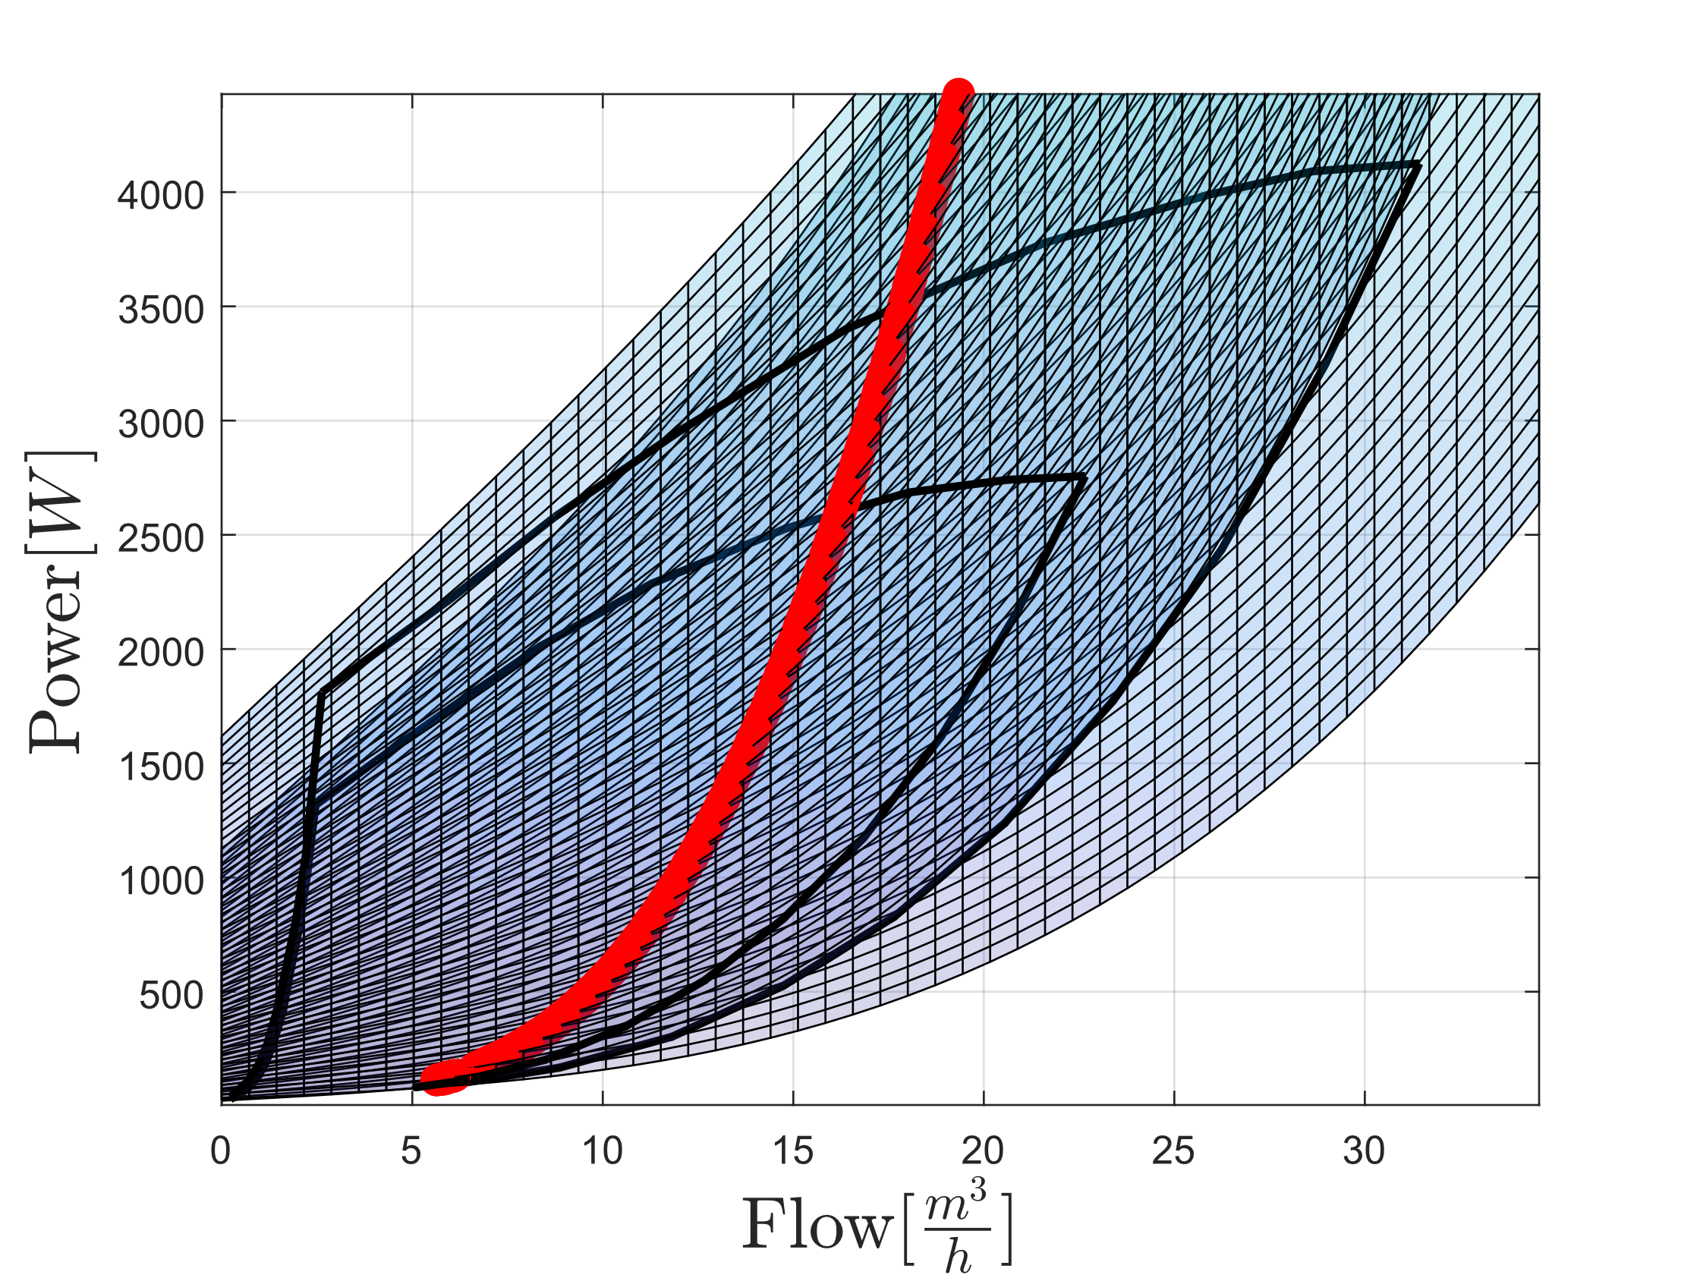
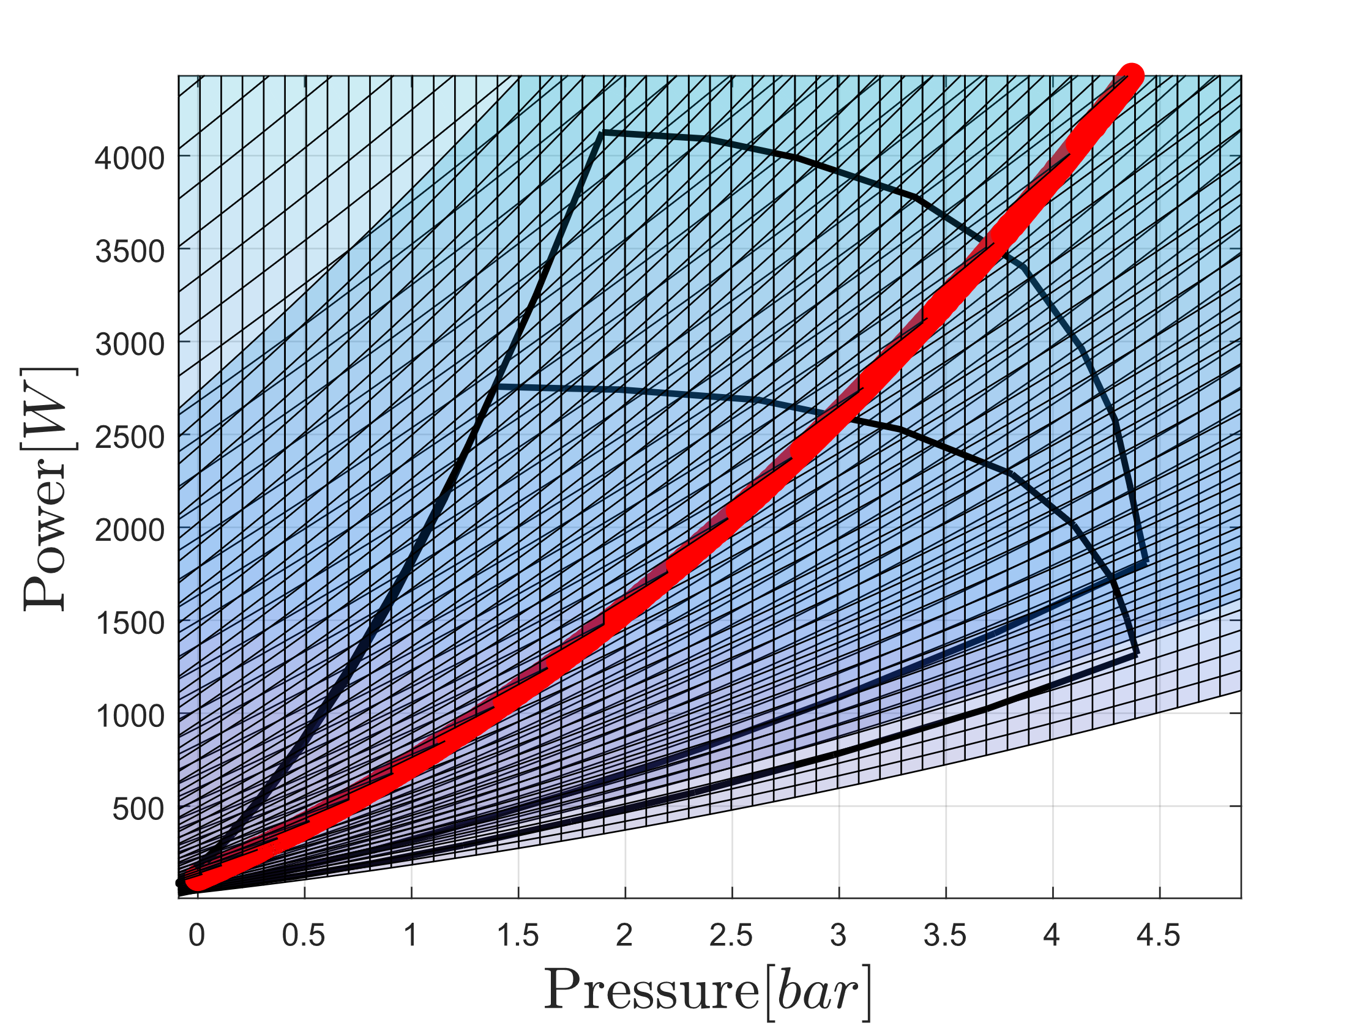

Slide 42
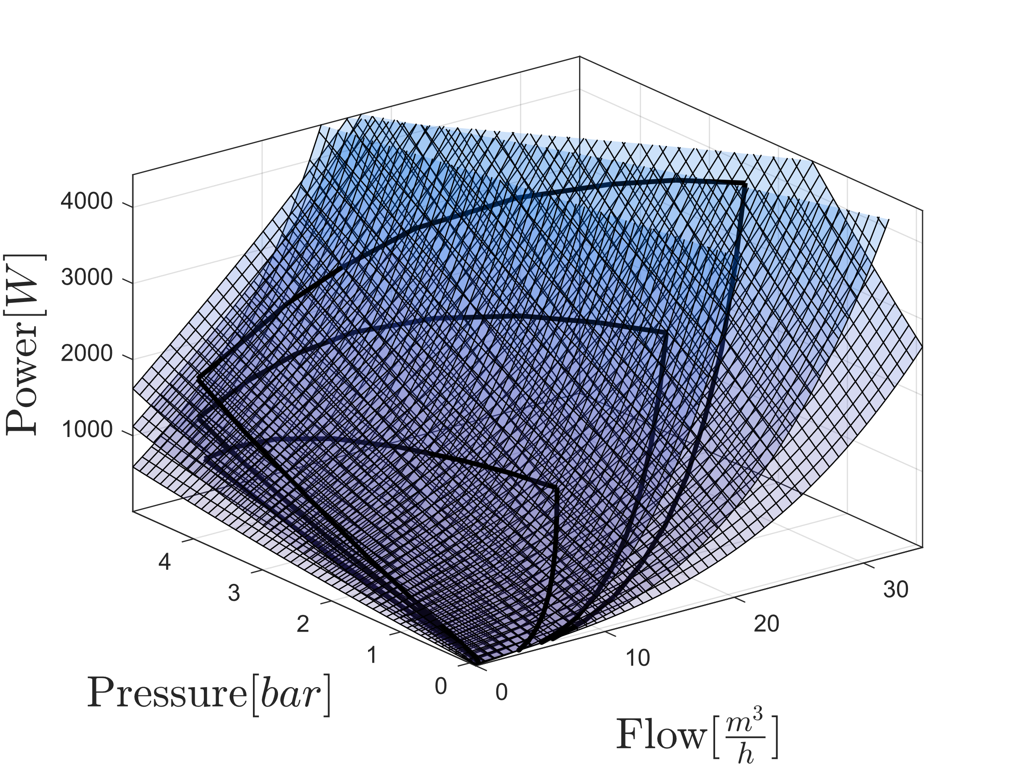
Model Combination
Combined Models

Slide 43
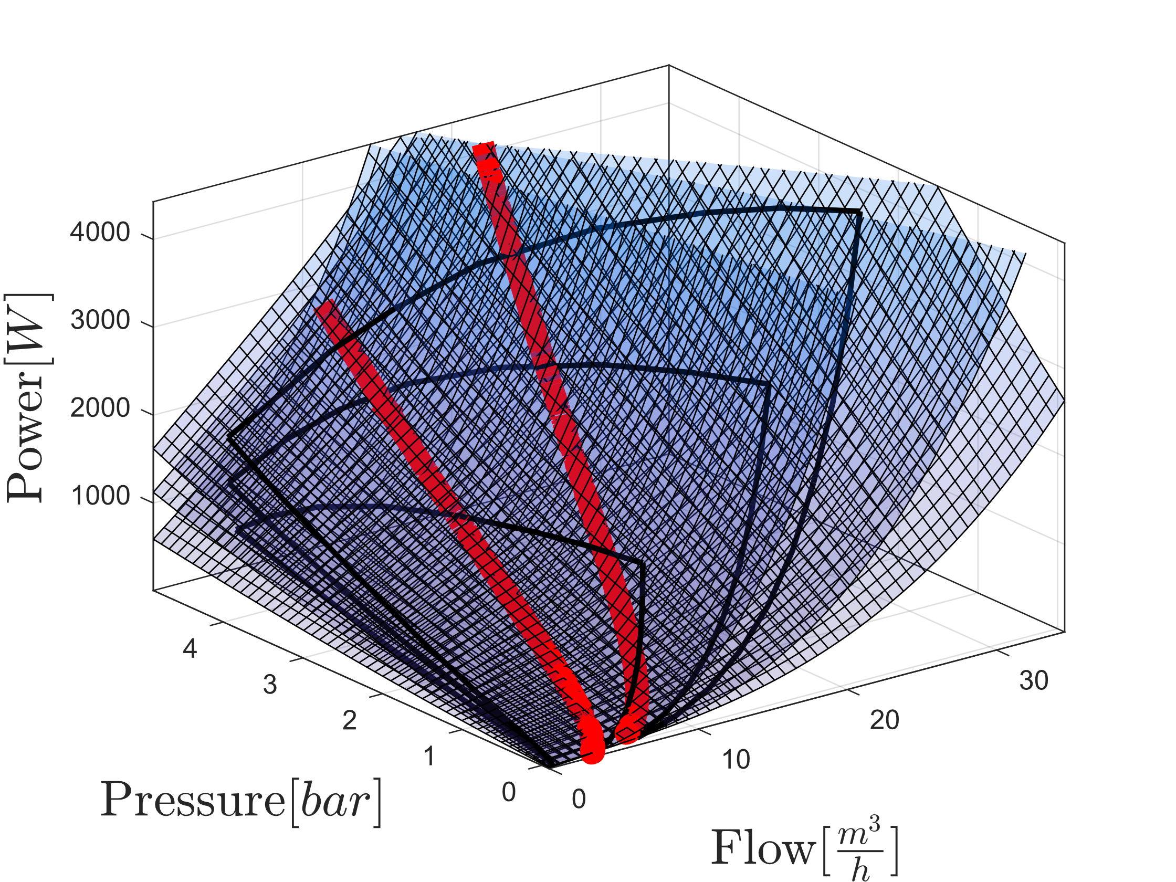
Model Combination
Combined Models with intersection highlighted

Slide 44
